Slide 1
Today's webinar will be recorded and posted on the Center for Evidence-based Policy website. Only the slides and presenter will be recorded.
Please use the chat function to ask questions. Questions will be answered after the presentation.
For assistance with Webex, please email plattk@ohsu.edu.

Slide 2
Center for Evidence-based Policy
Addressing policy challenges with evidence and collaboration

Slide 3
About Our Work
Support state policymakers by providing neutral and rigorous research and technical assistance services
Evidence review and synthesis
Data analytics: administrative data integration, management, and analysis
Policy analysis
Technical assistance (operational and process)
Trainings and workshops on evidence-based decision making
Notes:
Give examples of each as you go.

Slide 4
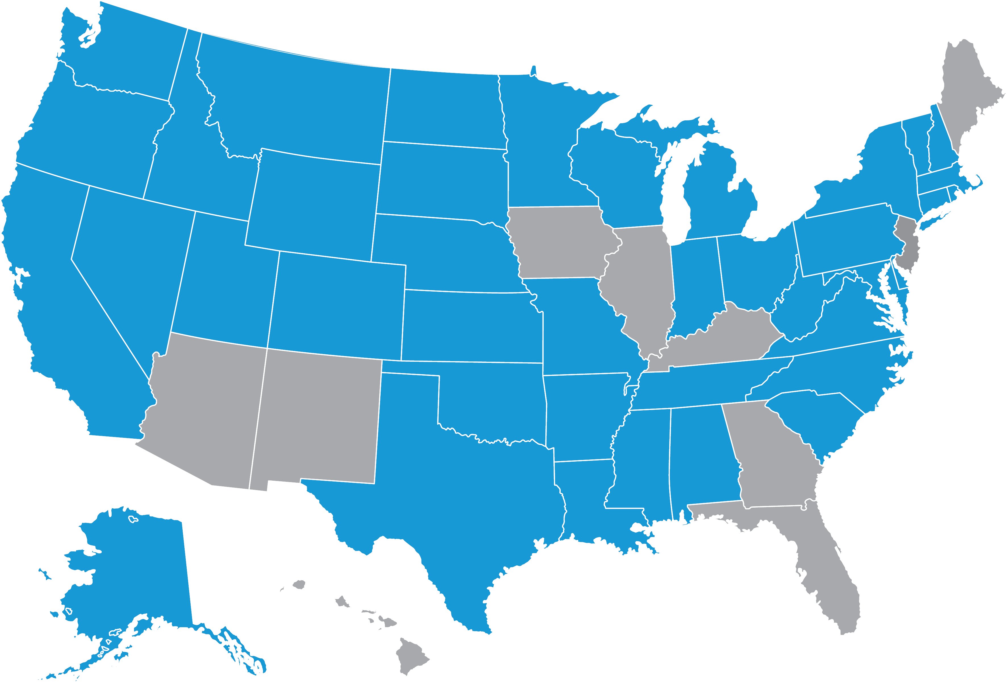
40 States Served Since 2003
States Served

Slide 5
About Our Organization
Established in 2003 at Oregon Health & Science University
Our work is driven by states, 90% in Medicaid
We are not funded by industry or associations
We are nonpartisan and we do not lobby
Our work is typically proprietary

Slide 6
Who Are We?
Center Staff:
Systematic reviewers
Policy analysts
Physicians
Pharmacists
Nurses
Genetics professionals
Epidemiologists
Librarians
Data scientists
Technical editors
Researchers
Work in 2024:
Produced 50 evidence reports
Researched 40 topics
Screened over 30,000 titles and abstracts
Reviewed in detail more than 3,000 research articles
Graded 600 articles for quality
Today:
Marcus Bachhuber Physician Researcher
Pam Curtis
Director
Amy Clary
Senior Policy Analyst,
Interim MED Director
Kelsey Platt
Project Coordinator

Slide 7
The Role of Clinicians Within Medicaid Agencies
Presented by
Marcus Bachhuber, MD MS FACP FASAM

Slide 8
Disclosure Information
Today’s presenter and the report authors do not have any conflicts of interest to disclose.

Slide 9
Overview
Background
Key Questions
Methods
Findings
State Considerations
Discussion and Future Work

Slide 10
Background: Topic Nomination
This topic was nominated by Medicaid Evidence-based Decisions (MED) project participants
MED is collaborative of 22 state Medicaid programs
State-driven governance and research agenda
Researchers at the Center for Evidence-based Policy developed and carried out the project, based on state feedback

Slide 11
Background: Medicaid Administration
To administer Medicaid, state agencies are tasked with a diverse set of responsibilities, such as:
Defining covered benefits
Creating payment structures and provider rates
Overseeing providers and delivery systems
Quality improvement
Maintaining program integrity
Managing utilization
Image source. Iconfinder

Slide 12
Background: Current Medicaid Landscape
Medicaid is the primary insurance source for over 20% of Americans, including many with complex medical needs, alongside significant system changes:
High Medicaid enrollment (~79 million)ª
Expansion of covered services
Payment and delivery system reform
Rising costs and emerging technologies
Image source. Iconfinder
Source: KFF. Medicaid enrollment and unwinding tracker.

Slide 13
Key Questions
How do state Medicaid programs structure their clinical staff?
What are the typical clinically oriented duties for clinical professionals on Medicaid program staff?
What are the duties Medicaid programs have clinicians perform that may not require clinical training?
Image source. Iconfinder

Slide 14
Methods
Searched relevant policy sources including guidance and information from the Centers for Medicare & Medicaid Services (CMS) and the Medicaid and CHIP Payment and Access Commission as well as policy briefs from organizations such as KFF and the Center for Health Care Strategies
Searched Ovid MEDLINE from 2013 onward
Interviewed officials from 6 state Medicaid programs
Mixture of managed care and fee-for-service
Diversity in geography and size of enrollment, from less than 100,000 to 2 million members
We have anonymized responses to preserve confidentiality
Interviewed officials from CMS

Slide 15
Findings

Slide 16
Findings
Clinical Staff Duties
Strategies to Enhance and Extend Clinical Expertise
Recruiting and Retaining Clinical Staff
Clinical Staff Structures and Resources

Slide 17
Findings
Clinical Staff Duties
Strategies to Enhance and Extend Clinical Expertise
Recruiting and Retaining Clinical Staff
Clinical Staff Structures and Resources

Slide 18
Findings: Clinical Staff Structures
Clinical-specific office
(3 states)
- Led by chief medical officer
- Contains majority of clinical staff
- Includes pharmacy and dental programs
Multifunction office with clinical concentration
(1 state)
- Clinical team sits within operations
- Contains most clinical staff/leaders, but not overseen by chief medical officer
- Pharmacy and dental in separate offices
Dispersed model
(2 states)
- Medical director(s) sits separately
- Clinical staff spread over multiple teams
- Pharmacy sits separate from medical
Image source. Iconfinder

Slide 19
Findings: Clinical Staff Resources
State | Medical Directors | Pharmacists | Dentists
A | 1 (typically 2) | 3 | 1
B | 1 | 8 | 0 (1 dental hygienist)
C | 14 (9 full-time) | 8 | 1
D | 4 | 4 | 2
E | 4 (3 full-time) | 6 (3 exclusively Medicaid) | 1 (half-time) (2 dental hygienists)
F | 1 | 3 | 0

Slide 20
Findings: Clinical Staff Resources—Nursing
Formed largest single category of clinicians in majority of states (from 1 to 35+ clinicians within the 6 states interviewed)
Filled wide variety of roles, including:
Leadership
Program management (e.g., maternal health)
Clinical analytics
Quality improvement and contract oversight
Utilization management
Long-term care intake and support
Program integrity

Slide 21
Findings: Clinical Staff Resources—Behavioral Health
Interviewees reported different types of behavioral health clinicians on staff, both in clinical-specific offices and separate behavioral health offices
Clinicians included:
Psychiatrists and addiction medicine physicians
Psychologists
Licensed clinical social workers
Licensed professional counselors and therapists
Applied behavioral analysis providers
Leadership positions included behavioral health office director, behavioral health medical directors, policy and benefit division director

Slide 22
Findings: Clinical Staff Resources—Hiring
Directly Employed
Contracted
(Full- or Part-Time)
Most common staffing arrangement
Fits within state organization chart
Typically managerial responsibilities within agency
External Consultants
State University Partnership
Flexible arrangements
Individuals or vendors
Often part-time or hourly staff
Typically embedded within the agency
Often more flexible compensation
Potentially faster hiring timeline
Benefits of being in academic institution

Slide 23
External Consultants: Examples
External contracts for agency roles:
Part-time pediatrics physician consultant
Dental director
Full-time pharmacists
Advisory consulting arrangements:
Clinical consulting vendors (e.g., independent reviews, specialty prior authorizations, clinical policy development)
Orthodontic evaluations
Hourly individual advisory consultation (e.g., specialty disciplines)

Slide 24
State University Partnership: Examples
Pharmacy positions
2 states support Drug Utilization Review programs in part through pharmacists at state schools of pharmacy
Clinical office in a state university
1 state has majority of clinical staff as university employees but generally embedded directly within the agency
Allows for several specialty part-time clinicians, including a pediatrician, audiologist, optometrist
Image source. Iconfinder

Slide 25
Findings
Clinical Staff Duties
Strategies to Enhance and Extend Clinical Expertise
Recruiting and Retaining Clinical Staff
Clinical Staff Structures and Resources

Slide 26
Findings: Clinical Staff Duties
Clinical Staff
Utilization Review
Benefits Administration
Provider Engagement
Program Integrity
Vendor Contracting and Oversight
Clinical Transformation Initiatives
Interagency Consultation
Agency Leadership, Committees, and Legislative Affairs

Slide 27
Utilization Review
Typically a core function of clinical staff
Role is typically direct in fee-for-service programs, with more of an oversight role with managed care
Additional member issues including complex placement issues and case-by-case exceptions
Final authorization decisions can fall to medical, pharmacy, and dental directors, and states may need specialty expertise for certain decisions

Slide 28
Benefits Administration
Significant area of involvement, especially for medical and pharmacy directors
Typically involves significant collaboration with other agency areas (policy, finance, operations)
Can include evidence review, external specialist consultation, regulatory review, criteria development, fiscal impact analysis

Slide 29
Benefits Administration: Examples
Medical, Dental, and Behavioral Health
Researching or implementing coverage of new services
Diagnosis and procedure code updates
Pharmacy
Managing the Preferred Drug List
Developing and maintaining prior authorization criteria
Mapping diagnosis codes to clinical disorders

Slide 30
Benefits Administration: State Example
Request to Cover New Sleep Device
Evidence Review
Utilization Analysis
State Budget Impact Analysis

Slide 31
Provider Engagement
Medical directors often serve as a face of the program with medical provider groups
Participate in specialty society meetings, provider workgroups, and statewide quality improvement initiatives
Lead formal programs that engage and support providers (e.g., infant and early childhood mental health programs)
Can help gather provider input on agency initiatives such as managed care procurement
Meet with providers having issues or concerns with managed care organizations (MCOs) or fee-for-service Medicaid

Slide 32
Program Integrity
Audits and chart reviews for fraud, waste, or abuse
Assisting Attorney General’s office in investigations
Monitoring program integrity provisions of vendor contracts

Slide 33
Vendor Contracting and Oversight
Vendors can include MCOs, independent review organizations, and utilization review vendors, among others
During procurement, requests for proposals and contracting can benefit from a “clinical eye” and experience as a provider
Quality review teams for vendors can include nurses and behavioral health clinicians
Vendors have clinical review teams, and states may need to employ similar expertise to resolve disputes
State clinical leadership may be called to weigh in and interact with vendor clinical leaders, and ultimately overrule decisions

Slide 34
Vendor Contracting and Oversight: Examples
Overseeing utilization review contracts
Selecting quality measures for MCO or value-based arrangements
Ongoing engagement with MCO medical directors
Evaluating operational reality of contract requirements

Slide 35
Clinical Transformation Initiatives
Consistently noted as one of the most engaging parts of the work
Include projects such as research studies and delivery and payment system reform projects
Clinical consultation on federal initiatives and grants (e.g., CMS Innovation Center)
Typically are cross-cutting initiatives involving multiple parts of the agency
Several states had a clinical lead alongside a finance or operations lead

Slide 36
Clinical Transformation Initiatives: Examples
Research studies (e.g., hospital-to-home randomized controlled trial)
Managed care performance improvement projects (quality improvement)
Implementation and refinement of value-based payment models
Primary care delivery transformation
Telehealth coverage expansion
Dental benefits expansion
Postpartum care eligibility extension
Opioid treatment benefit expansion
Health equity initiatives
Screening and interventions for social determinants of health
Community health worker benefit development and implementation

Slide 37
Clinical Transformation Initiatives: Example
Opioid Treatment Network Project Workflow
Idea generation
- At multidisciplinary team level, with 1 or 2 primary leads
Moving benefit to ongoing operations and maintenance
- Pharmacy team owns benefit
Implementation with defined clinical and operational leads
- Medical director and behavioral health operations lead
- Enhance treatment network
- Adjust pharmacy benefit

Slide 38
Interagency Consultation
Medicaid Clinical Staff
Public Health
Corrections
Aging and Long-Term Care
Children and Family Services
Behavioral Health
Develop-mental Disabilities
Increased agency consultation during COVID-19 pandemic
Formal relationships such as a percentage of time, serving on advisory committees
Informal support and consultation

Slide 39
Agency Leadership, Committees, and Legislative Affairs
Medicaid clinical leaders are part of agency executive leadership team or report directly to the agency director
Clinical leadership involved in longer-term agency strategic planning and priorities (e.g., high-profile clinical program initiatives, waiver development)
Consistent roles in legislative issues, including bill analysis, fiscal impact analysis, and legislator interactions
Clinical staff can be very involved with state government committees such as the Medical Care Advisory Committee, Drug Utilization Review Board, and Pharmacy and Therapeutics Committee

Slide 40
Findings
Clinical Staff Duties
Strategies to Enhance and Extend Clinical Expertise
Recruiting and Retaining Clinical Staff
Clinical Staff Structures and Resources

Slide 41
Enhancing and Extending Clinical Expertise (1 of 7)
Medicaid staff use the following strategies to bring in additional clinical resources in a cost-effective manner:
Leveraging enhanced federal match
Collaboration with state agencies, quality improvement collaboratives, MCOs
Additional university relationships
Part-time positions or contracts

Slide 42
Enhancing and Extending Clinical Expertise (2 of 7)
Relatively high salaries of clinical staff can be a barrier to hiring
Since 1978, CMS has offered an enhanced Medicaid administrative match of 75% for “compensation and training of skilled professional medical personnel [SPMP] and staff directly supporting those personnel”
Skilled Professional Medical Personnel Definition
“Physicians, dentists, nurses, and other specialized personnel who have professional education and training in the field of medical care or appropriate medical practice and who are in an employer-employee relationship with the Medicaid agency. It does not include other nonmedical health professionals such as public administrators, medical analysts, lobbyists, senior managers or administrators of public assistance programs or the Medicaid program.”
Source: 42 CFR §432.20, §433.15
Image source. Iconfinder

Slide 43
Enhancing and Extending Clinical Expertise (3 of 7)
The enhanced SPMP match offers states significantly higher federal funding to help improve the affordability of clinician staff
Comes with the trade-off of time and effort for documentation to support enhanced SPMP claiming
2024 CMS guidance also provides information on SPMP claiming for behavioral health clinicians

Slide 44
Enhancing and Extending Clinical Expertise (4 of 7)
Medicaid staff offered perspectives on how to enhance the impact of these positions:
Clinical versus administrative Medicaid operations
Prioritizing support infrastructure
Fostering a clinical hub and integrating clinical view agency-wide
Leveraging internal specialty expertise
External Medicaid leadership programs
Creating clinical and operational leads for innovation projects

Slide 45
Enhancing and Extending Clinical Expertise (5 of 7)
Clinical versus administrative Medicaid operations
Administrative activities included:
Agency managerial roles
Simple individual tasks (e.g., scheduling, Excel, data visualization)
Project administration roles (e.g., project management, vendor operations)
Clinicians in multiple states felt that their “clinical eye” or “lens” brought significant value to the agency for many of these administrative duties
Also, administrative work could help drive the agency’s broader clinical agenda
Synergy of clinical skill set with administrative tasks in the ability to triage urgency, manage multiple sources of data, and make decisions in the face of uncertainty

Slide 46
Enhancing and Extending Clinical Expertise (6 of 7)
Prioritizing support infrastructure
Administrative and project support staff can help optimize use of clinician time and reduce burnout
Creating clinical and operational leads for innovation projects
Clinical leadership alone may not be sufficient for cross-cutting initiatives
Operations, policy, or finance co-leads for projects can increase impact
Fostering a clinical hub and integrating clinical view agency-wide
Interviewees reported tremendous value in having a sense of clinical team, and the ability to discuss policy and programmatic ideas with other clinicians

Slide 47
Enhancing and Extending Clinical Expertise (7 of 7)
Leveraging internal specialty expertise
Clinicians have different specializations and experiences, as well as diverse professional networks
Projects and other responsibilities can be assigned based on experiences and interest, which can increase effectiveness
External Medicaid leadership programs
Some interviewees had participated in the Milbank Memorial Fund Fellows and Emerging Leaders Programs, and the Center for Health Care Strategies Medicaid Pathways Program
Valued the opportunity to work with legislators, exchange ideas with other states, and receive direct coaching on leadership

Slide 48
Findings
Clinical Staff Duties
Strategies to Enhance and Extend Clinical Expertise
Recruiting and Retaining Clinical Staff
Clinical Staff Structures and Resources

Slide 49
Recruiting and Retaining Clinical Staff (1 of 3)
Medicaid clinical staff reported the below key factors for recruitment and retention:
Highlighting the Medicaid mission
Finding the next generation of clinical leaders
Ongoing clinical practice
Pursuing compensation improvement, where possible
Increasing clinical leader engagement through balanced portfolios

Slide 50
Recruiting and Retaining Clinical Staff (2 of 3)
Highlighting the Medicaid mission
Staff clinicians are drawn to the core mission of providing services to Medicaid members
Finding the next generation of clinical leaders
A new generation of clinical leaders is progressing through academic pipelines
Clinicians with significant health system experience can provide valuable perspective
Increasing clinical leader engagement through balanced portfolios
Building work portfolios with both long- and short-term projects and reserving some level of project support for these positions may help retention
Positions heavy in repetitive work (e.g., service authorizations) without much variety or opportunities for creative work are prone to burnout and turnover

Slide 51
Recruiting and Retaining Clinical Staff (3 of 3)
Ongoing clinical practice
Many interviews felt there is value in providing clinicians with a pathway to continue practicing (including retention), but state rules vary
Receiving Medicaid payments while having a policy making role is generally viewed as a conflict of interest
Some states have created a pathway to clinical practice, including a state statute, a conflict of interest review committee, practice at Veterans Affairs facilities only, and Medicaid Director approval of practice site with salaried or hourly compensation
Pursuing compensation improvement, where possible
States have access to the SPMP federal match to try to address the private-public compensation gap, and university contracting may offer another mechanism

Slide 52
State Considerations

Slide 53
State Considerations (1 of 3)
Enhanced SPMP federal match
External relationships
Fostering a clinical hub
Applying a clinical lens
Recruitment, retention, impact
Image source. Iconfinder

Slide 54
State Considerations (2 of 3)
Explore ways to take advantage of the enhanced SPMP federal match
75% enhanced match can help improve affordability of clinical roles
2024 guidance allows SPMP match for certain behavioral health clinical staff
Consider options to leverage external relationships
Establish university relationships, explore contract consulting, and work with existing state collaboratives
Pursue strategies to improve clinical staff recruitment, retention, and impact
Provide a pathway for continued clinical practice, build balanced work portfolios, prioritize support infrastructure, and improve compensation to the degree possible

Slide 55
State Considerations (3 of 3)
Foster a clinical nexus or hub within the agency
Organize clinical staff to provide a more unified clinical leadership voice and enable clinical collaboration across disciplines and projects
Consider ways to integrate and apply a clinical lens agency-wide
Build clinical and operational tracks for larger initiatives, integrate clinical and financial perspectives, add a clinical lens to more operational projects

Slide 56
Discussion

Slide 57
Discussion
States have different staffing structures and a wide variety of external relationships to add and extend clinical expertise
Clinical training and experience added value across the agency, ranging from payment reform to benefit development to vendor contracting
Clinical policymaking and leadership broadly play an important role in shaping Medicaid programs

Slide 58
Ongoing Work at the Center for Evidence-based Policy (1 of 4)
Medical, dental, and behavioral health: Medicaid Evidence-based Decisions Project (MED) – 22 states
Pharmacy: Drug Effectiveness Review Project (DERP) – 14 states
Technical assistance to individual states – 7 states in 2024

Slide 59
Ongoing Work at the Center for Evidence-based Policy (2 of 4)
Medicaid Evidence-based Decisions Project
Genetic Testing
Behavioral Health
eHealth
Durable Medical Equipment
Develop-mental Disabilities
Managed Care

Slide 60
Ongoing Work at the Center for Evidence-based Policy (3 of 4)
Drug Effectiveness Review Project
Gene Therapies
Behavioral Health Drugs
Physician-Administered Drugs
Biologics and Biosimilars
Pipeline Therapies
Weight Management Drugs

Slide 61
Ongoing Work at the Center for Evidence-based Policy (4 of 4)
State Technical Assistance
Health Technology Assessment
State and Federal Health Policy Review
Clinical Guideline Review and Analysis
Data Aggregation and Analysis
Clinical Consultation
Insurance Coverage Policy Analysis
Process Development

Slide 62
We'd love to hear from you!
Thank you!
Questions?
bachhmar@ohsu.edu

Slide 63
Learn More
Profiling State Biomarker Testing Legislation in Medicaid
May 22 at 12 PM (PT)
Evidence Synthesis Series mailing list
News and reports from the Center for Evidence-based Policy

