Slide 1
Medicaid Policy Matters Webinar Series Medicaid Management Strategies for Practitioner Administered Drugs
December 9, 2025

Slide 2
Webinar Aims
INTRODUCTION
Today’s webinar will focus on state Medicaid strategies for managing practitioner-administered drugs with a special attention to oncology treatments, where management may help control growing costs while ensuring enrollees receive appropriate, high-quality care.

Slide 3
Executive Summary
#1
#2
#3
Program Design and Coordination
Increase Coordination Between Medical and Pharmacy Benefits within Medicaid
Medical and pharmacy benefit coordination
Clinical criteria alignment
Program implementation
Financial Management
Tools to Manage Risk
Reimbursement pathways
Carve-outs
Vendor Management
Improve PAD Management Through Vendors and Contracting
Vendor Roles:
Clinical programming
Financial management
Contracting

Slide 4
About the Center for Evidence-based Policy

Slide 5
About Our Work
Center for Evidence-based Policy
Rigorous and neutral research and technical assistance services to support state policymakers
Evidence review and synthesis
Data analytics including administrative data integration, management, and analysis
Policy analysis
Technical assistance (operational and process-related)
Trainings and workshops on evidence-based decision making

Slide 6
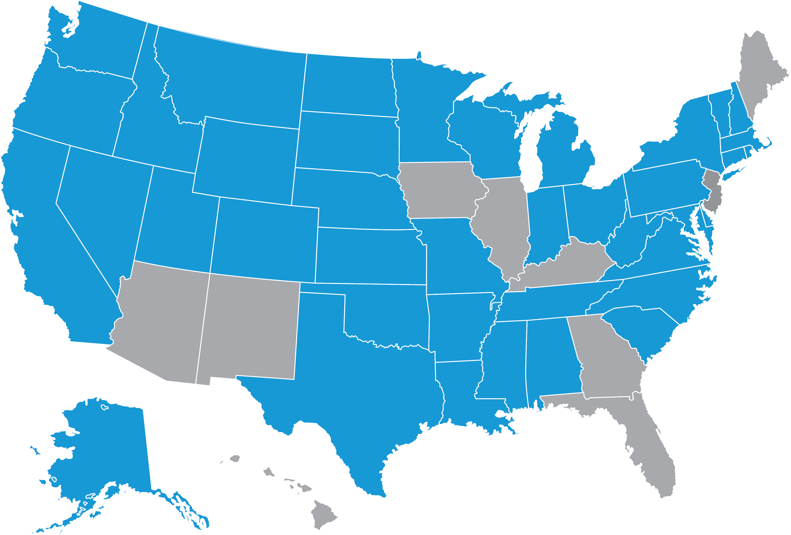
40 States Served Since 2003
Center for Evidence-based Policy
States served

Slide 7
About Our Organization
Center for Evidence-based Policy
Established in 2003 at Oregon Health & Science University
Our work is driven by states, 90% in Medicaid
We are not funded by industry or associations
We are nonpartisan and we do not lobby
Our work is typically proprietary

Slide 8
Who Are We?
Center for Evidence-based Policy
Our Staff
Systematic reviewers
Policy analysts
Physicians
Pharmacists
Nurses
Genetics professionals
Epidemiologists
Librarians
Data scientists
Technical editors
Researchers
Our Work in 2024
Produced 50 evidence reports
Researched 40 topics
Screened over 30,000 titles and abstracts
Reviewed in detail more than 3,000 research articles
Graded 600 articles for quality
Today
Chelsea Keating Policy Analyst
Rhonda Anderson
Director of Pharmacy/DERP
Pam Curtis Director
Kelsey Platt Project Coordinator

Slide 9
Medicaid Policy Matters Webinar Series Medicaid Management Strategies for Practitioner Administered Drugs
December 9, 2025

Slide 10
Agenda Overview
Overview
Background and Overview
State Considerations
Program Design and Coordination
Financial Management
Vendor Management
Discussion and State Considerations

Slide 11
Background and Overview

Slide 12
PAD Definition
Background and overview
Practitioner-administered drugs (PADs) exist in a shared middle space between medical and pharmacy services. These treatments are typically dispensed by injection or infusion in an office, clinic, or infusion center by a medical professional or health care provider. The administration of these drugs has introduced multiple variables that are difficult for state Medicaid agencies to manage due to clinical, financial, and compliance challenges.

Slide 13
Background
Background and overview
PADs are treatments that can be managed either in the medical or pharmacy benefit
Navigating the clinical, financial, and administrative challenges of PADs is challenging
On January 25, 2024, the Medicaid and CHIP Payment and Access Commission (MACPAC) presented an analysis of PAD utilization and spending:
Medicaid Coverage of Physician-Administered Drugs
Medicaid gross spending before rebates: $10,350,700,000
Full-year equivalent beneficiaries using PADs: 18.7%
Notes:
MACPAC carefully noted this analysis was likely an undercount of PADs because many PADs are reimbursement as part of a bundled payment.

Slide 14
Carve-Out Definitions
Report Definitions
Bundled payment carve-out
Separate reimbursement for PADs otherwise included in an inpatient or outpatient bundled payment (e.g., DRG and APG payments) or per diem payment
Medical claim carve-out
PADs required to be reimbursed through a pharmacy claim as opposed to a medical claim
MCO carve-out
PADs or other identified drugs or services required to be paid and administered through the FFS program rather than being covered by the MCO benefit
Abbreviations. APG: Ambulatory Patient Groups; DRG: diagnosis-related group; FFS: fee-for-service; MCO: managed care organization; PAD: practitioner administered drug.

Slide 15
State Considerations Preview
Report Aims
#1
#2
#3
Program Design and Coordination
Increase Coordination Between Medical and Pharmacy Benefits within Medicaid
Medical and pharmacy benefit coordination
Clinical criteria alignment
Program implementation
Financial Management
Tools to Manage Risk
Reimbursement pathways
Carve-outs
Vendor Management
Improve PAD Management Through Vendors and Contracting
Vendor roles:
Clinical programming
Financial management
Contracting

Slide 16
Program Design and Coordination
#1
Notes:
Chelsea

Slide 17
Medical and Pharmacy Benefit Coordination
Program design and coordination
Clinical Coverage Policies and Management Benefit placement decision making
PAD Program Management Program implementation Claims editing Prior authorization
Staffing and Change Management Leverage staff expertise and vendors to manage PAD programs

Slide 18
Benefit Placement Approaches
Program design and coordination
PADs have historically defaulted to medical benefit due to site of administration in a clinical setting
The growing need to manage PADs has highlighted differences in approaches across medical and pharmacy benefits:
Medical benefits may have less structured claim adjudication processes, with some coverage issues addressed post-administration
Pharmacy benefits use structured prepayment authorization and clinical management processes
Often real-time adjudication

Slide 19
Benefit Placement Considerations
Program design and coordination
States' decisions to cover drugs under the medical or pharmacy benefit typically occur on a case-by-case basis for each drug or therapeutic class
Major considerations:
Site-specific policies and prices
Drug pricing
Available utilization management tools
Opportunities for rebate collections
Clinical safety

Slide 20
PAD Program Implementation
Program design and coordination
States use several factors to prioritize PADs for management:
Drug class or provider type (e.g., biologics for rheumatoid arthritis)
FDA approval category (e.g., cell and gene therapy)
Treatments with specific administration requirements (e.g., self-injectables, injectable factor products for hemophilia)
High utilization with high potential of off-label use (e.g., Botox)
Notes:
A common theme throughout the state Medicaid agency interviews was the need to determine how and when to implement a PAD management program

Slide 21
Claims Editing and Programming
Program design and coordination
Implementing claim-level edits (medical or pharmacy claim fields with specific coding requirements needed for approval; age, gender, units) across the pharmacy and medical benefit may:
Determine clinical appropriateness when a prior authorization is not feasible due to legislation or capacity
Reduce likelihood of duplicate billing on both the medical and pharmacy benefit
State challenges associated with aligning clinical criteria across benefits:
Implementing edits for PADs covered under the medical benefit
Implementing edits in Medicaid Management Information System (MMIS) claims processing
Keeping PADs under medical benefit to enable access without clinical edit for step therapy as required by pharmacy benefit

Slide 22
Prior Authorization
Program design and coordination
Utilization management (UM) strategies, including prior authorization, are used by clinical teams
Drive utilization to drugs that yield cost savings or have higher clinical effectiveness
For oncology drugs, many products have multiple indications where clinical effectiveness depends on the specific cancer indication
Typical UM strategies prefer products across all indications
Cost management for oncology therapies is primarily cost avoidance as opposed to cost savings
Potential savings comes from the program avoiding additional costs for therapies that would have been wasted or were not clinically appropriate
Notes:
General PA then…
ONCOLOCY:
Emphasizing again why oncology is different to other classes

Slide 23
Oncology Clinical Guidelines
Clinical management
Standard review elements, implemented in a prior authorization or claims-edit, include:
FDA label
Biomarker results
Drug indications
Among the state Medicaid programs we reviewed, those with additional criteria primarily rely on the National Comprehensive Cancer Network (NCCN) for criteria information. Example language includes:
“…the standard for the appropriate indication will include the FDA label as well as current NCCN guidelines.”
“…level of evidence of Category 1 or 2A.”

Slide 24
Prior Authorization Federal Regulation
Program design and coordination
Major considerations
PAD prior authorization requests must be handled by a system that responds by telephone or other telecommunication device within 24 hours
PADs subject to prior authorizations must also have at least a 72-hour supply available in an emergency situation

Slide 25
Staffing and Change Management
Program design and coordination
Opportunities for alignment between medical and pharmacy teams:
Clearly divide responsibilities and handoffs:
Example: Pharmacy benefit staff are accountable for proactively reviewing drugs and new market entrants, while medical benefit staff are responsible for coverage criteria
Increase staffing with specialized PAD program administration
Adding program integrity pharmacists with PAD specialization (i.e., board-certified oncology pharmacists)
Increase data analysis expertise to help monitor utilization and optimize potential rebates

Slide 26
Financial Management
#2

Slide 27
Financial Management for PADs
Reimbursement methodologies and pathways for PAD claims Inpatient: bundle payment and carve-out Outpatient: medical and pharmacy claims
Rebate challenges Medicaid Drug Rebate Program (MDRP) and 340B considerations
Carve-outs Managed Care Organizations (MCOs) carve-outs and high-cost risk pools

Slide 28
PAD Reimbursement Methodologies
Financial Management
As payers, reimbursement methodologies are a primary tool for managing costs and ensuring access to care
Notable variation in PAD reimbursement methods across sampled Medicaid programs but some alignment around states' use of Medicare pricing as a benchmark
Average sale price (ASP) + 6%
Variation typically found in:
Which pricing benchmark used in states' “lesser of logic”
Unique treatment of individual PAD classes (e.g., clotting factor)
Use of 340B-specific pricing methodology
340B drug reimbursement has potential to compensate providers significantly above acquisition cost if reimbursement methodology does not account for the 340B discount

Slide 29
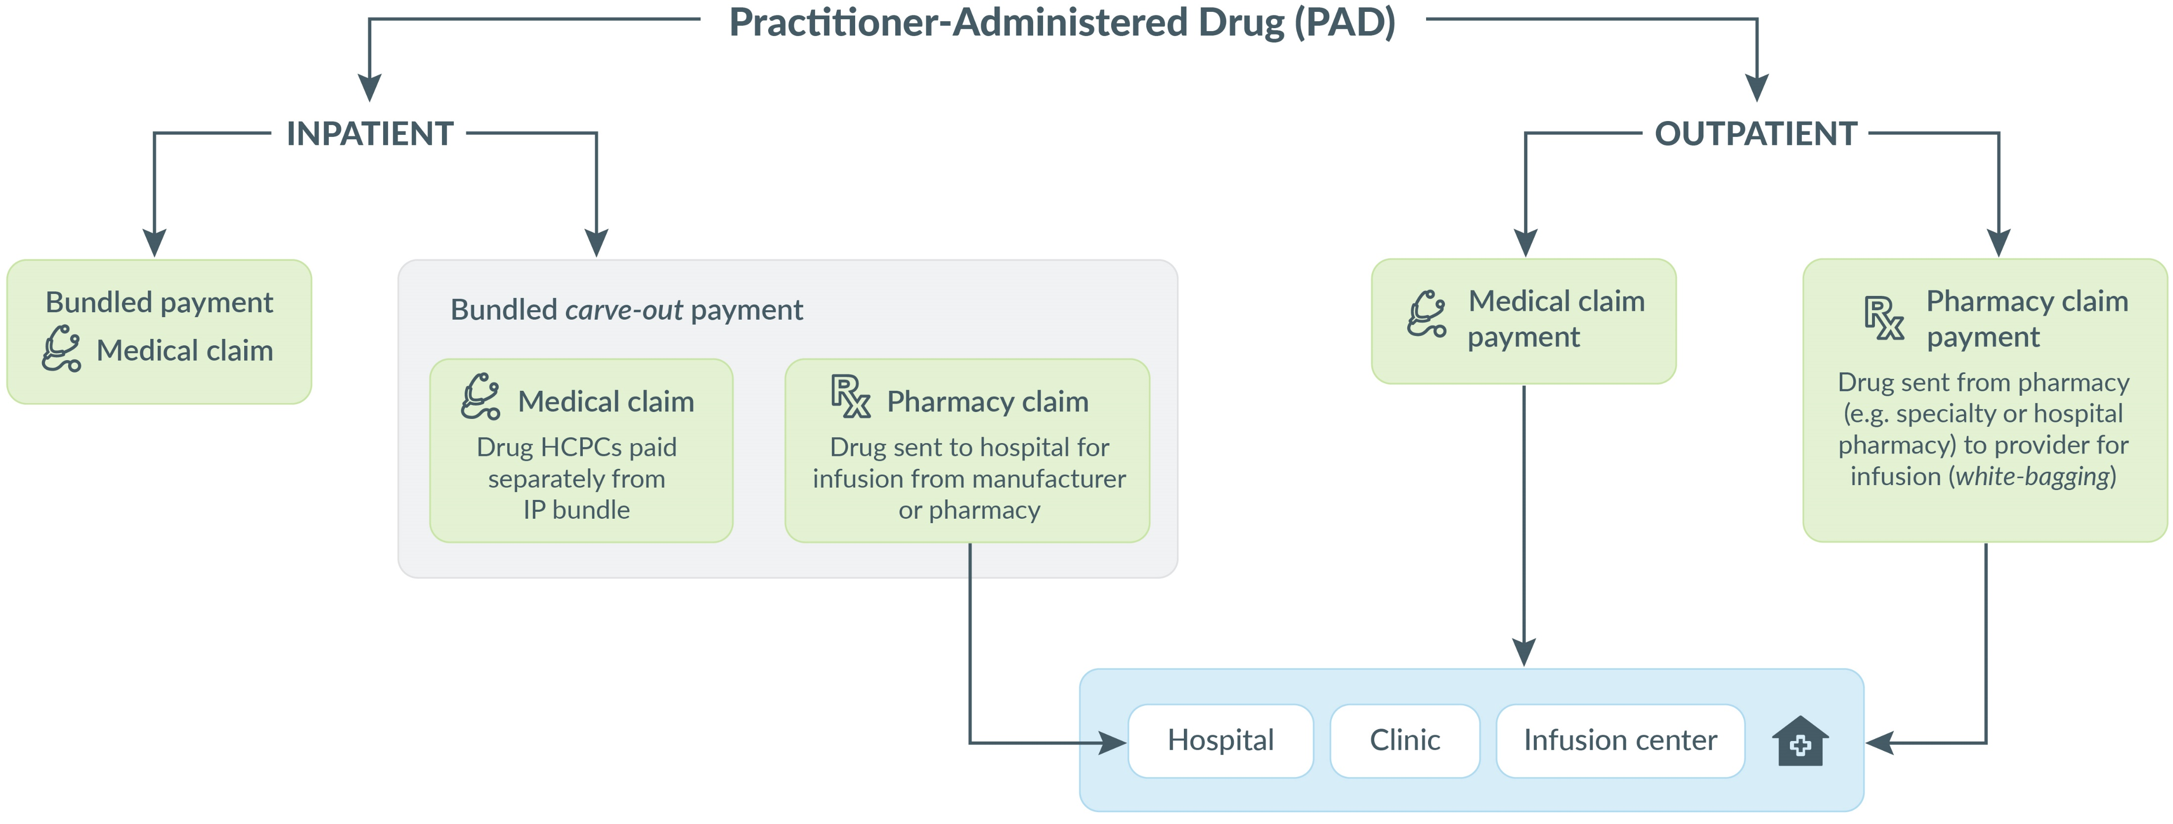
PAD Reimbursement Pathways
Financial Management

Slide 30
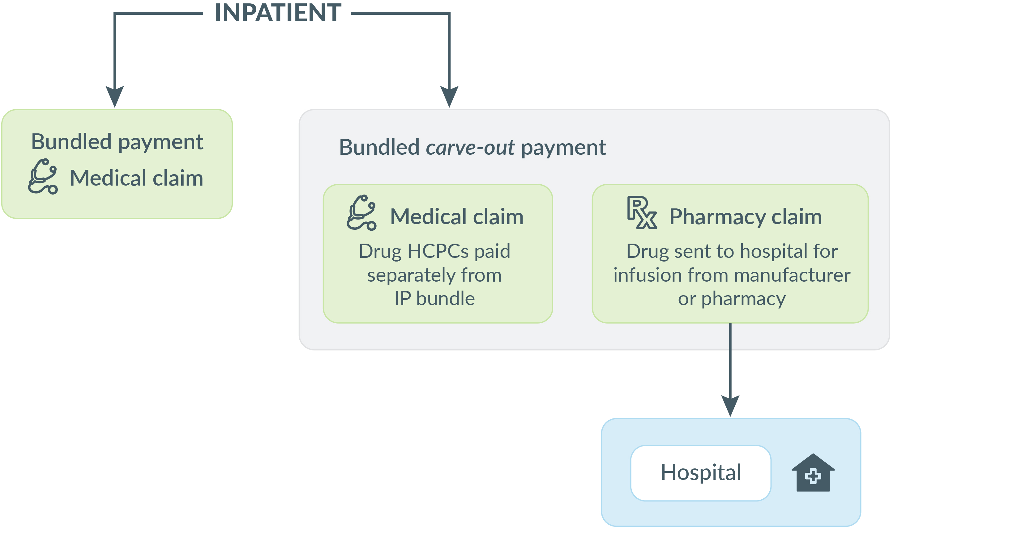
Inpatient Bundled Carve-Out Examples
Financial Management
A review of state Medicaid programs identified PAD bundle payment carve-outs for:
Cell and gene therapies
Orphan and rare diseases
Endocrine
Oncology

Slide 31
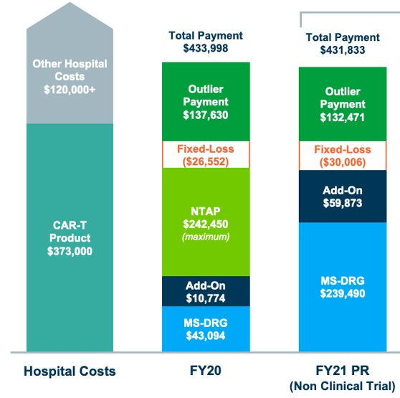
Inpatient PAD Reimbursement
Financial Management
Kymriah: Hospital Reimbursement Under Inpatient Prospective Payment System (IPPS)
Bundled payment:
Medical claim – prospective payment
Hospital buy and bill arrangement
Bundled carve-out payment:
Medical claim:
PAD separated from bundled payment and paid as a separate line item
Pharmacy claim:
PAD reimbursement on a pharmacy claim
Remainder of the bundled payment is on a medical claim
Image source. Avalere

Slide 32
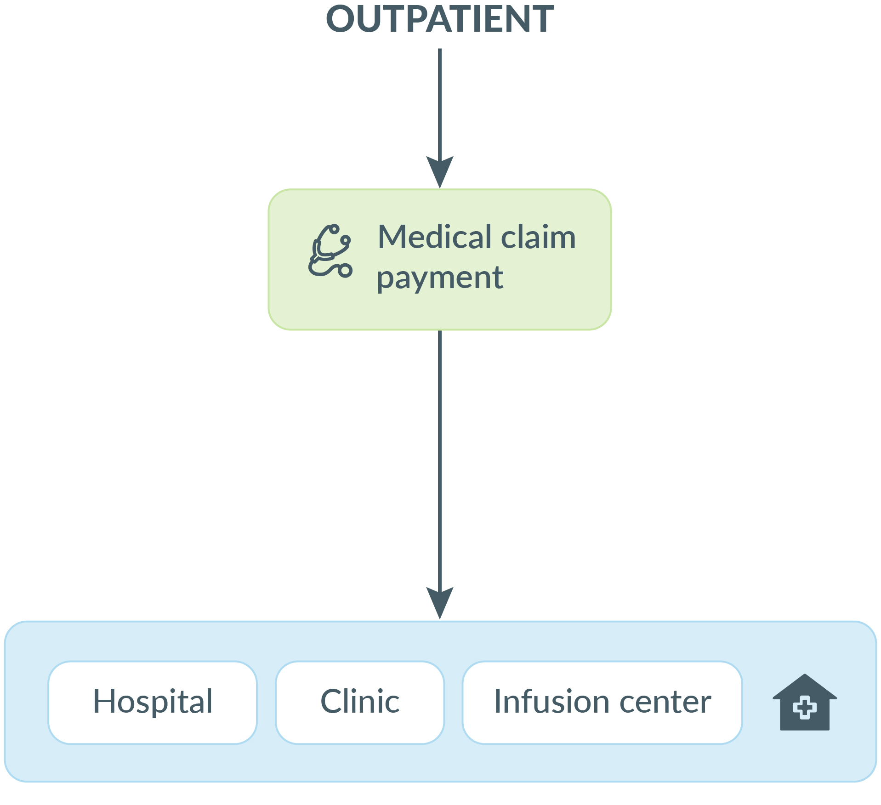
Outpatient Medical Claim PAD Reimbursement
Financial Management
Reimbursement:
Medical claim using HCPCS
National Drug Code (NDC) is required (in addition to HCPCS)
Ensures product is in the Medicaid Drug Rebate Program (MDRP)
Considerations:
Site of care policies
Medical claims system capabilities with reimbursement
Utilization management criteria
340B modifiers

Slide 33
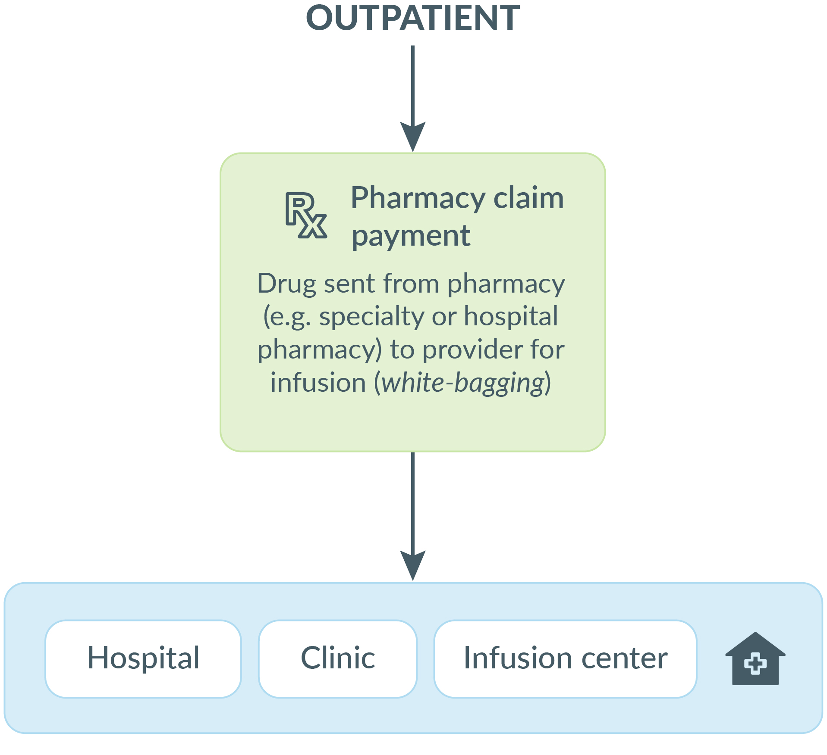
Outpatient Pharmacy Claim PAD Reimbursement
Financial Management
Reimbursement:
Pharmacy “lesser of logic” based on reference pricing (e.g., AWP, WAC)
Considerations:
Access with buy and bill policies
Pharmacy utilization management strategies (e.g., preferred drug lists)
Duplicative billing on a medical claim
340B modifiers

Slide 34
Oncology PAD Management Strategies
Cost management for oncology therapies is primarily cost avoidance as opposed to cost savings​
Potential savings comes from the program avoiding additional costs for therapies that would have been wasted or were not clinically appropriate
Product Type​ | Utilization Management Strategy​
Oral​ | Generics First​
Oral​ | Split Fill​
Oral and PADs​ | Preferred drug list​
Oral and PADs​ | Max units or quantity limits​
PADs​ | Drug wastage or dose rounding​
Increased Complexity
PAD: practitioner-administered drug

Slide 35
Rebate Collection Challenges
Financial management
Common State Challenges
Challenges | Potential strategies
Inaccurate information on claims (e.g., wrong NDC, wrong units, etc.) | Provider education on common billing errors Claim edits using HCPCS to NDC crosswalks
Excluding 340B utilization at entity/provider level instead of the claim-line level | Require providers to use "UD" and "UC" coding indicating definitively when non-340B stock was used Ensure rebate processor is excluding utilization based on line-level coding rather than using entity-level exclusions
Miscellaneous codes used for non-rebateable PADs | Limit use of miscellaneous codes to a defined list of allowable drugs Enforce the policy restriction by pending claims with miscellaneous code for manual review or claim edits if possible

Slide 36
High-Cost Drug Policy in Managed Care: Fee-for-Service Carve-Out
Financial Management
Rationale for MCO carve-outs of certain drugs:
Increase state leverage for supplemental rebate negotiations
Centralize control for UM processes
Address uncertain financial risk
Need for a clear communication process, and systems to coordinate authorizations for carve-out drugs and additional care patients are receiving
MCO RISK POOLS FOR HIGH-COST PRODUCTS
Useful if there is concern that distribution of risk is uneven across MCOs
Risk pools rely on cost projections and are often funded by premiums that reduce MCO capitation rate
Example treatments: Cell and Gene Therapies

Slide 37
Vendor Management
#3

Slide 38
Vendor Management
Working with vendors: Pharmacy Benefit Managers (PBMs) Pharmacy Benefit Administrators (PBAs)
Rebate aggregators Ensure appropriate management of rebate programs
Vendor contracting Larger contract (e.g., module, subcontracted) or as a stand-alone contract Performance-based contract terms

Slide 39
Working With Vendors
Vendor Management
Vendors can be used to fully administer PAD programs or provide some level of support to in-house teams
Identify opportunities for management of oncology drugs
May lead to additional cost savings or cost avoidance
Extensions of their own team to help with capacity
PAD management added into pharmacy-related RFPs are becoming more common
CLINICAL PROGRAMMING
Monographs
P&T or DUR committee support
Peer-to-peer support
FINANCIAL MANAGEMENT
Rebates
Carve-out drug programs
Utilization management and preferred drug lists

Slide 40
Pharmacy Benefit Managers (PBMs) and Pharmacy Benefit Administrator (PBAs) Roles
Vendor Management
Using PBMs and PBAs to administer benefits can be challenging due to high costs and reduced state control over policy and operational decisions
Some states are reducing reliance on PBMs and PBAs
Example: state is hiring more staff to support committee deliberations and the development of PAD clinical monographs, previous work completed by a vendor
Resource constraints can limit what functions states administer themselves
Coding crosswalks (e.g., NDC to HCPCS or PAD unit conversions) may be too resource intensive for states to actively manage without a vendor
Notes:
Interview participants noted vendor management can be challenging due to high cost of the program and limited state control
Recent state agency request for proposals and request for information examples are included on page 16 of report
Due to high price of PAD services from PBMs and PBAs, some states that had previously used vendors to operate PAD program have moved some work in-house
One Medicaid program is hiring more clinicians to help build clinical monographs and support P&T deliberations to reduce reliance on vendors
Medicaid staff may want to continue using claims editing and NDC to HCPCS crosswalks from vendors as the burdens of maintaining these resources may be too high to bring in house.

Slide 41
Federal and State Compliance With Vendors
Vendor management
When using vendors, states must ensure compliance with applicable state and federal regulations
Specific federal requirements apply to managed care plans using pharmacy vendors
Increased data reporting requirements
Adjustments to medical loss ratio (MLR) calculation
PBM impact on medical loss ratio calculation
Discounts, rebates, and spread pricing must be adjusted out of the service cost component of the MLR
PBMs must share data for accurate calculation of MLR
Managed care plans must require this data sharing in contract with the PBM
Notes:
States delegating administrative functions to a vendor need robust reporting and oversight to ensure compliance with applicable federal and applicable state regulations
Including regulations for transparency and fiscal accountability that also apply to contracted managed care plans
Federal regulations require that only amount reimbursed to providers and pharmacies count toward medical expenditure component of Medical Loss Ratio (MLR) for managed care plans
Discounts, rebates, spread pricing should not be included
PBMs must share underlying data necessary for MLR calculation with MCOs
MCOs must include these data reporting requirements in contract with third-party vendor to ensure accurate and compliant calculation

Slide 42
Rebate Aggregators
Vendor management
Rebate aggregators are common to ensure appropriate management of rebate programs
Rebate aggregators: vendors who specialize in negotiating rebates with manufacturers, collect claims data to bill rebates, and collect rebate dollars on an entity's behalf
Aggregators are moving toward outcomes-based arrangements (OBAs) with manufacturers, but some states work directly with manufacturers to determine clinical outcomes for OBAs
Common rebate aggregator pain points include:
340B submission limitations
Scanning and removing 340B claims at entity level instead of claim level, which removes more claims than necessary and reduces eligible rebate revenue
Additional fees for system upgrades to implement
Crosswalk compliance checks, expanded digit allowance on payment amounts, validating rebate eligibility by checking NDC against MDRP fields
Notes:
Clearly define what is an “entity – level” – savings could be in the millions and regionally specific
Explain the relationship of provider + member + drug = 340B approval

Slide 43
Vendor Contracting
Vendor management
Vendor support for PAD programs may be part of a larger contract (e.g., module, subcontracted) or as a stand-alone contract
Terms used in performance-based contracts:
Risk-based contracts
Service-level agreements (e.g., PA reviewer specialty match)
Key performance indicators
Performance withholds, penalties, or liquidated damages

Slide 44
Discussion and State Considerations

Slide 45
State Considerations (1 of 3)
Discussion and state considerations
#1
Program Design and Coordination
Increase Coordination Between Medical and Pharmacy Benefits Within Medicaid
Leadership support |  | Secure agency leadership support to integrate the clinical teams responsible for PADs on both the medical and pharmacy benefits, establishing shared decision making and regular management meetings
Clinical criteria |  | Protect patients and prompt medical providers with clinical and prior authorization criteria to verify use of best prescribing practices based on current peer-reviewed evidence
Medical claim edits |  | Enhance medical claim editing for PADs under the medical benefit and align with pharmacy benefit claims editing where appropriate

Slide 46
State Considerations (2 of 3)
Discussion and state considerations
#2
Financial Management
Tools to manage risk
Provider reimbursement |  | As payers, reimbursement policy is a key financial management lever, and states should evaluate whether their methodology is efficient.
Rebate challenges |  | Resolve nonspecific drug coding, policy, and operational pitfalls that leave rebate dollars unclaimed by ensuring providers are using correct NDC and HCPCS code combinations, correct unit amounts, and appropriate 340B modifiers.
High-cost drug policy in managed care |  | High-cost drugs present a unique challenge for states, particularly in the context of managed care. States have used different strategies, such as carve-outs and risk pools to address this challenge.

Slide 47
State Considerations (3 of 3)
Discussion and state considerations
#3
Vendor Management
Improve PAD Management Through Vendors and Contracting
Vendor role |  | Reevaluate the role of the state’s PBM or administrator to be more active with PAD oversight (e.g., clinical monographs, code crosswalks, claim edit checks).
Monitor performance |  | Develop a contract management strategy with performance standard monitoring for vendors (MCOs, PBMs, PBAs, rebate aggregators) that participate in clinical and financial benefit of PADs.
Contracting |  | Evaluate various strategies, such as performance-based contracting to ensure you receive the full value of a PAD program.

Slide 48
Additional Resources for Participating States
In addition to the SMART-D PAD Brief and the DERP Oncology: Preferred Drug Management Strategies policy report, the Center has the following items that are relevant to this work:
Genetic Testing Workgroup
Includes collaborative meetings with a genetic counselor, various biomarker reports, and fiscal estimate guides
Cell and Gene Therapy reports
New Gene Therapy Treatments for Sickle Cell Disease
Zolgensma (onasemnogene abeparvovec-xioi) budget impact model
Rebates: Value-based payment reports

Slide 49
Questions and Discussion
Medicaid Policy Matters Webinar Series

Slide 50

GLP-1 Adherence and Safety: Medicaid real-world data
Thursday, February 26, 2026 at 11:00am (Pacific Time)

Slide 51
State Pain Points (1 of 4)
State pain points and considerations
Reimbursement and clinical criteria
Staffing
Rebates and MCOs
Notes:
Three identified pain points of many discussed.

Slide 52
State Pain Points (2 of 4)
State pain points and considerations
Reimbursement and clinical criteria
Reimbursement and pricing challenges with hospitals and other providers
Difficulty implementing standard clinical coverage criteria and reimbursement methodologies across the medical and pharmacy benefits
Claim-level edits enforcing clinical criteria are applied when billed, which is not always same date of administration for PAD drug
Staffing
Rebates and MCOs

Slide 53
State Pain Points (3 of 4)
State pain points and considerations
Reimbursement and clinical criteria
Staffing
Lack of interdisciplinary staffing across the medical and pharmacy benefits necessary for shared management of PADs in both the FFS and MCO programs
Limited staff expertise to craft PAD requirements for both MCO contracts and vendor contracts for PAD clinical and cost management
Rebates and MCOs

Slide 54
State Pain Points (4 of 4)
State pain points and considerations
Reimbursement and clinical criteria
Staffing
Rebates and MCOs
Difficulty invoicing for rebates due to inadequate controls and gaps in provider coding, identification and exclusion of 340B drugs, and poor data quality from MCOs
Frequent requests from MCOs to carve-out certain high-cost drugs, many of which are PADs

