Slide 1
Medicaid Policy Matters Webinar Series Using Public Dashboards to Support Evidence-based Decisions
April 21, 2026

Slide 2
Webinar Aims
INTRODUCTION
Introduction to two publicly available, interactive data dashboards with examples of how each may be used to inform actual policy questions

Slide 3
Executive Summary
INTRODUCTION
Stop drowning in data. Start driving decisions.
Data is the backbone of smart policy, but the sheer volume of available information can obscure the path forward. The Center for Evidence-based Policy has developed several specialized public data dashboards.
These resources were designed to transform complex datasets into clear, interactive visualizations that support smarter, evidence-driven policy decisions.
Today we’ll demonstrate two:
State Medicaid by the Numbers
Oregon Child Integrated Dataset – Child Well-being Dashboard

Slide 4
About the Center for Evidence-based Policy

Slide 5
About Our Work
Center for Evidence-based Policy
Rigorous and neutral research and technical assistance services to support state policymakers
Evidence review and synthesis
Data analytics including administrative data integration, management, and analysis
Policy analysis
Technical assistance (operational and process-related)
Trainings and workshops on evidence-based decision making

Slide 6
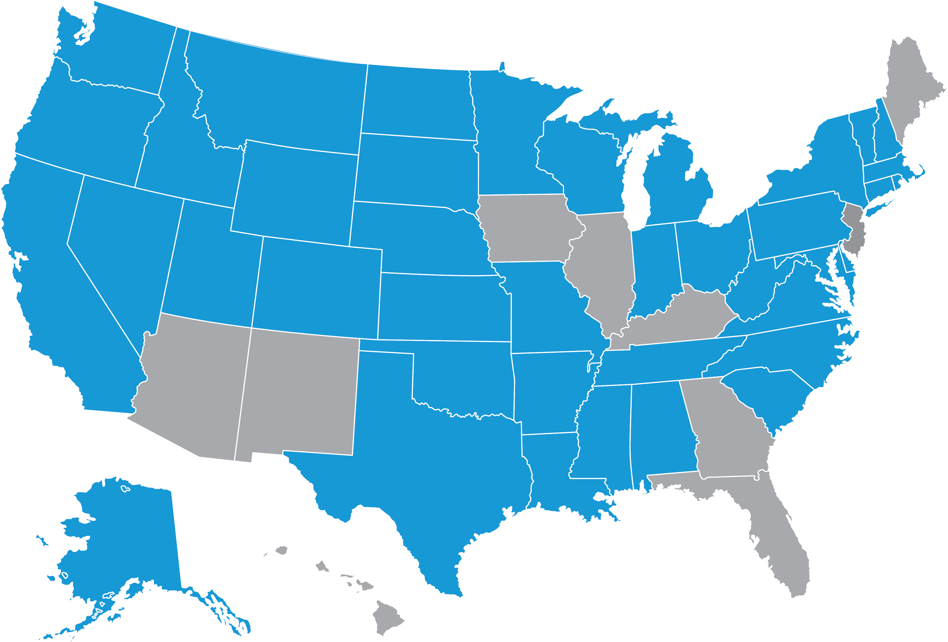
40 States Served Since 2003
Center for Evidence-based Policy
States served

Slide 7
About Our Organization
Center for Evidence-based Policy
Established in 2003 at Oregon Health & Science University
Our work is driven by states, 90% in Medicaid
We are not funded by industry or associations
We are nonpartisan and we do not lobby
Our work is typically proprietary

Slide 8
Who Are We?
Center for Evidence-based Policy
Our Staff
Systematic reviewers
Policy analysts
Physicians
Pharmacists
Nurses
Genetics professionals
Epidemiologists
Librarians
Data scientists
Technical editors
Researchers
Our Work in 2025
Produced 50 evidence reports
23 policy briefs
Researched 40 topics
Screened over 30,000 titles and abstracts
11 surveillance reports
Graded 600 articles for quality
180 unique projects
Today
David Radley
Director - Data & Analytics
Dylan Miksicek
Research Associate
Morgan Reader
Data Visualization
Pam Curtis Director
Kelsey Platt Project Coordinator

Slide 9
Medicaid Policy Matters Webinar Series Using Public Dashboards to Support Evidence-based Decisions
April 21, 2026

Slide 10
Agenda Overview
Overview
State Medicaid by the Numbers
Oregon Child Integrated Dataset – Child Well-being Dashboard
Discussion

Slide 11
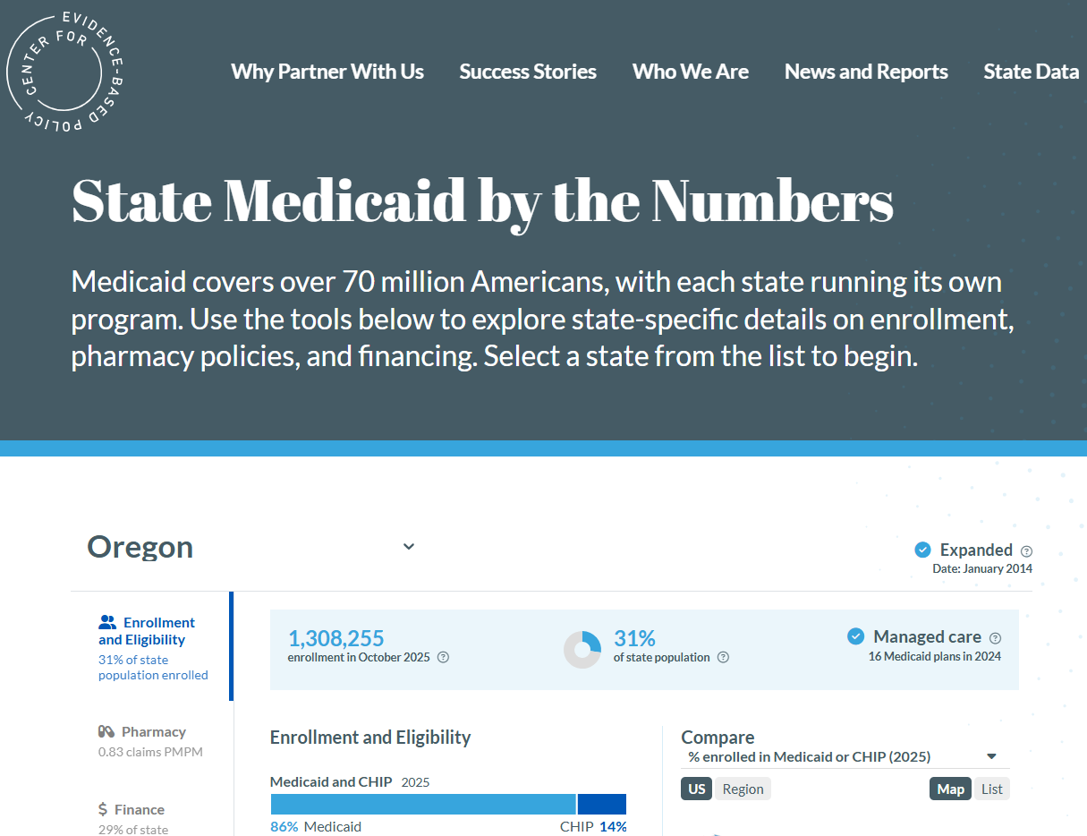
State Medicaid by the Numbers
Public tool containing state-specific Medicaid profiles
Summarizes Medicaid enrollment, financing, and pharmacy in each state
Links to state-specific resources like fess schedules and billing manuals

Slide 12
Approach
Aggregate data from public sources:
CMS, Census (American Community Survey), KFF, National Assoc. State Budget Officers (NASBO), state websites
Data included are a reflection of the places we source it
Potential for discordance between your own understanding and what is publicly reported
Solicited feedback from state policy makers to focus on the things that matter most to them
Describe aspects of state Medicaid programs that inform policy and decision making
Evolve content and functionality over time

Slide 13
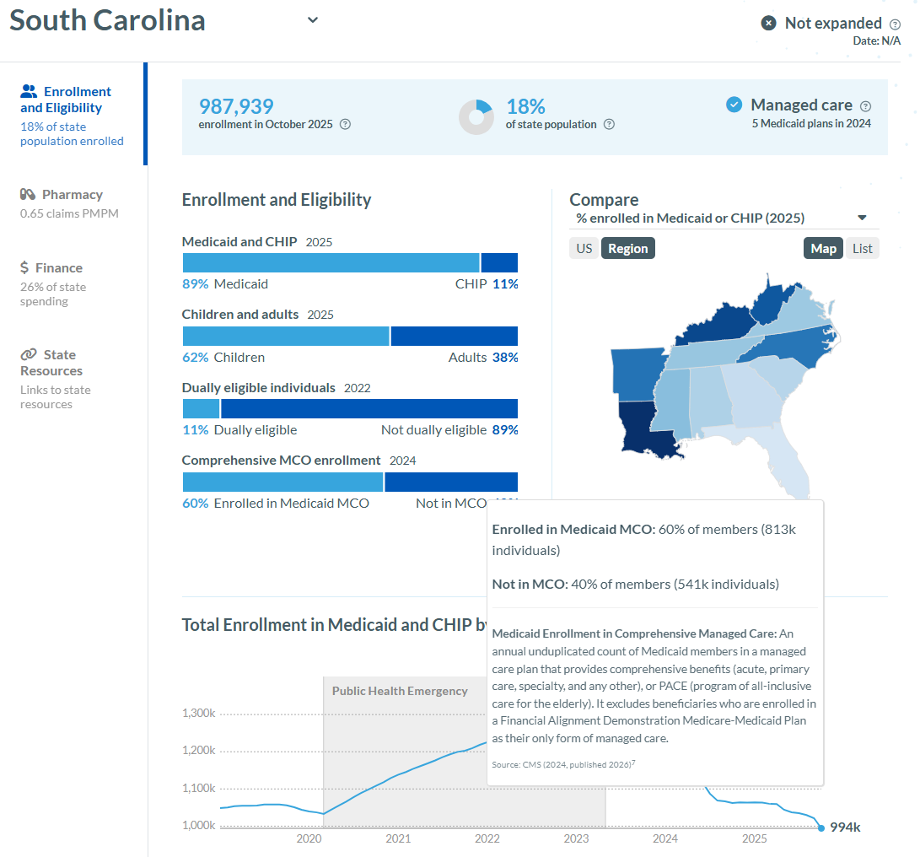
(1) Select state of interest
(2) Information is grouped into four sections:
Enrollment
Pharmacy
Financing
State resources
(3) Featured information specific to the selected domain
(4) National and regional comparisons
(5) Hover boxes contain definitions, additional details, and links to data sources
1
3
2
4
5

Slide 14
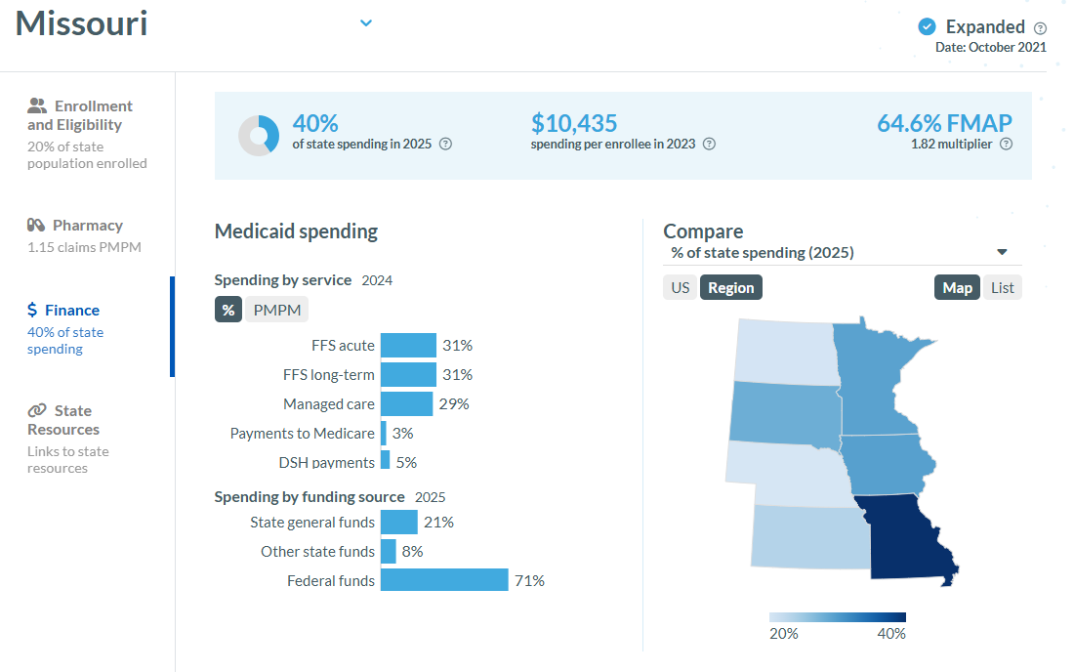
Vignette 1. Regional Comparison of Per Enrollee Spending
A state policy analyst in Missouri is wondering how their state’s Medicaid spending per enrollee compares to neighboring states
Solution: Use the state profile tool to access the finance (1) dashboard, which shows Medicaid (2) total spending per capita for their state and for comparison states (3)
Select the measure(s) for comparison from the drop down
Select US or Regional radio button
View data on Map (with hover or in a list)
2
1
3

Slide 15
Vignette 1 – live demo

Slide 16
Vignette 2. Explore State Approaches to Pharmacy Management
A policy maker is interested in pharmacy costs in their state and is considering new strategies for pharmacy cost management. They are curious how other states approach pharmacy
Solution: Maybe they want to discuss strategies with colleagues from other states; they could…
Identify a set of candidate states based on geography, relationships, etc.
Profile candidate states based on characteristics that they may be able to leverage for cost savings (e.g., approach to PDL, pharmacy carve out, use of high-cost drugs—these are in the tool)

Slide 17
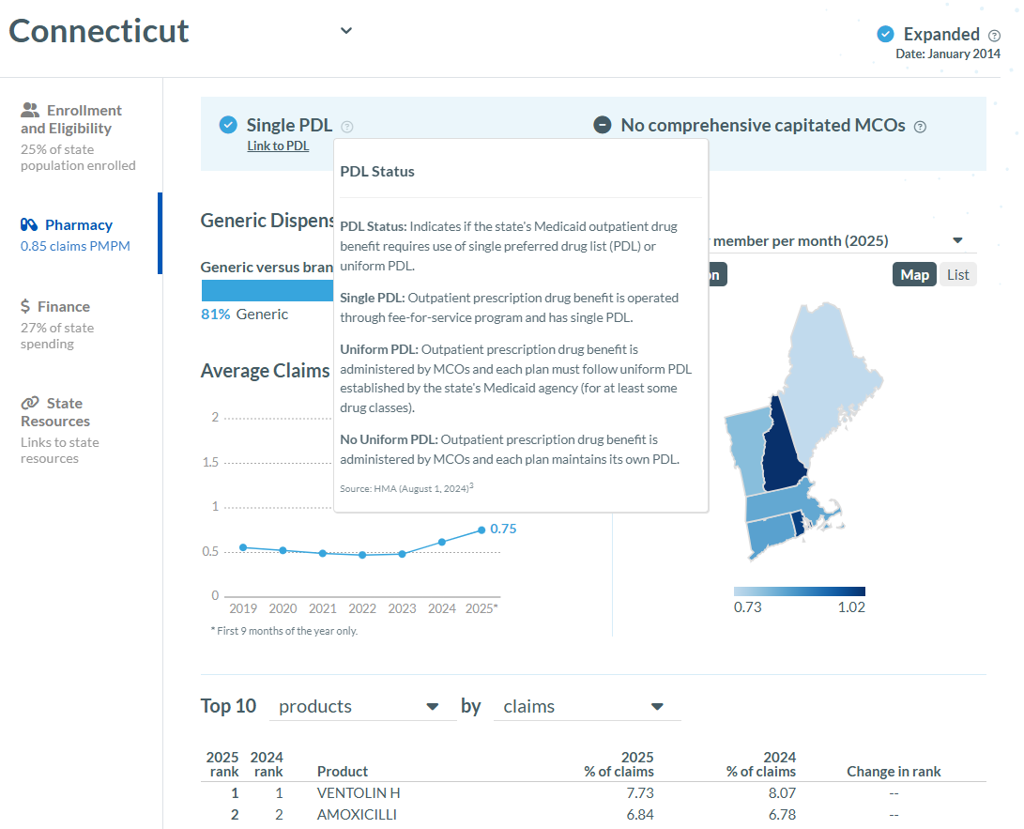
Vignette 2. Explore State Approaches to Pharmacy Management
1
Candidate states: AK, CT, ID, SC
Does the state use a single PDL? Single PDL is an important lever for states’ efforts to manage costs
How is pharmacy managed in the state? MCO, Hybrid, MCO carve out, FFS? Use the hover tool to get more detail about the system used in the state.
Which drugs does the state spend the most on? Select “products” and “cost” from the pull-down menus
2
3
4

Slide 18
Vignette 2 – live demo

Slide 19
Public Link https://centerforevidencebasedpolicy.org/medicaid-by-the-numbers

Slide 20
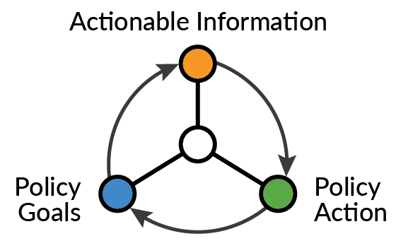
OCID Child-wellbeing Dashboard
Oregon Child Integrated Dataset (OCID)
Objective: Actionable Information for Policymaking in Oregon
Nonpartisan, objective resource to improve the well-being of all children in Oregon
Oregon-specific, cross-program data across childhood starting in 2001
Responsive and accessible in-depth analyses and interactive data visualizations
Governed by state policymakers and guided by community leaders

Slide 21

Overview of Current Program Data in OCID
Oregon Department of Human Services
Child maltreatment
Foster care
SNAP
TANF
Oregon Youth Authority
Allegations
Residential placement
Oregon Department of Education
Assessments
Attendance
Graduation
Discipline
Disability status
Early Intervention/Early Childhood Special Education
English language proficiency
9th grade on-track to graduate
Student houselessness
Health
Education
Safety
Nutrition
Housing
Early
Learning
Oregon Health Authority
Babies First!/Maternity Case Management
Medicaid/CHIP claims and enrollment
Oregon birth & death records
Department of Early Learning and Care
Employment-related Day Care
Head Start/Oregon Pre-K
Healthy Families Oregon Home Visiting
Oregon Child Integrated Dataset at ocid-cebp.org
21

Slide 22
OCID Child Well-being Dashboard Intent
Create a central public resource for monitoring key indicators on how well our systems are working to support children and families in Oregon
Use evidence and policy relevance to drive content to better target policy decision making and inspire new questions, engagement, and inquiry
Leverage the cross-program and longitudinal data in OCID to provide a deeper understanding of selected indicators to allow policymakers to make better informed decisions
Engage subject matter experts within agencies and other key partners in building the dashboard to increase understanding of how the tool augments and enhances other measurement and transparency efforts

Slide 23
Future Development
Student houselessness
Juvenile commitment
School attendance
High school graduation
Prenatal care
Well-child visits, ages 0-3 (screening/developmental milestones)
Well-child visits, 3-17 (annual visits, incl. adolescent focus)
3rd grade reading
Behavioral health (self-harm)
Early childhood/other (TBD)
Notes:
Dylan

Slide 24
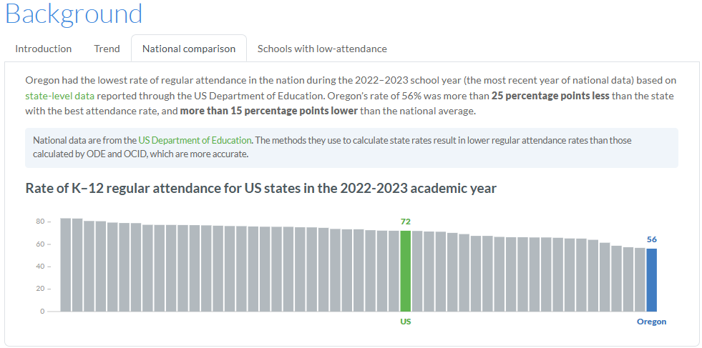
Individual Indicator Pages
Indicator page links
Juvenile commitment
Student houselessness
Regular attendance
High school graduation
Features of each page
Background: Issue context, state trend, national comparison, indicator-specific deep dive
Sociodemographics: Can select multiple
Multiple geographies: Specific to indicator
Key child experiences: Specific to indicator
Resource list: Relevant OCID, agency, national research

Slide 25
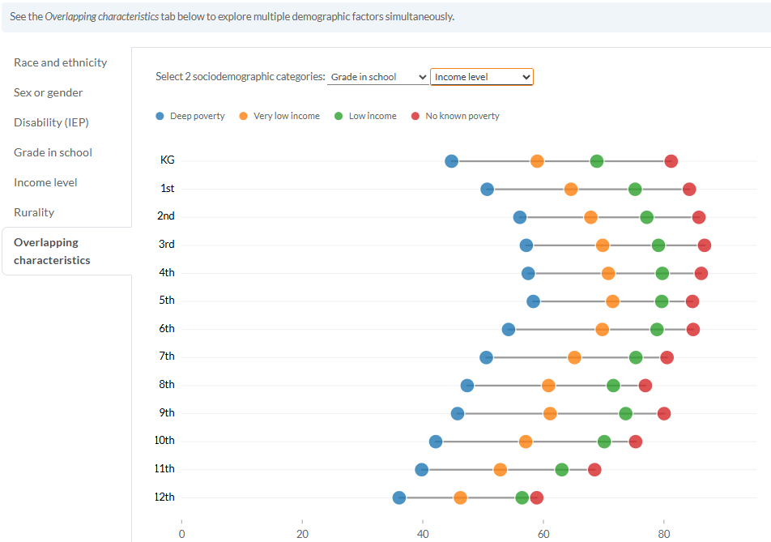
Individual Indicator Pages
Indicator page links
Juvenile commitment
Student houselessness
Regular attendance
High school graduation
Features of each page
Background: Issue context, state trend, national comparison, indicator-specific deep dive
Sociodemographics: Can select multiple
Multiple geographies: Specific to indicator
Key child experiences: Specific to indicator
Resource list: Relevant OCID, agency, national research

Slide 26
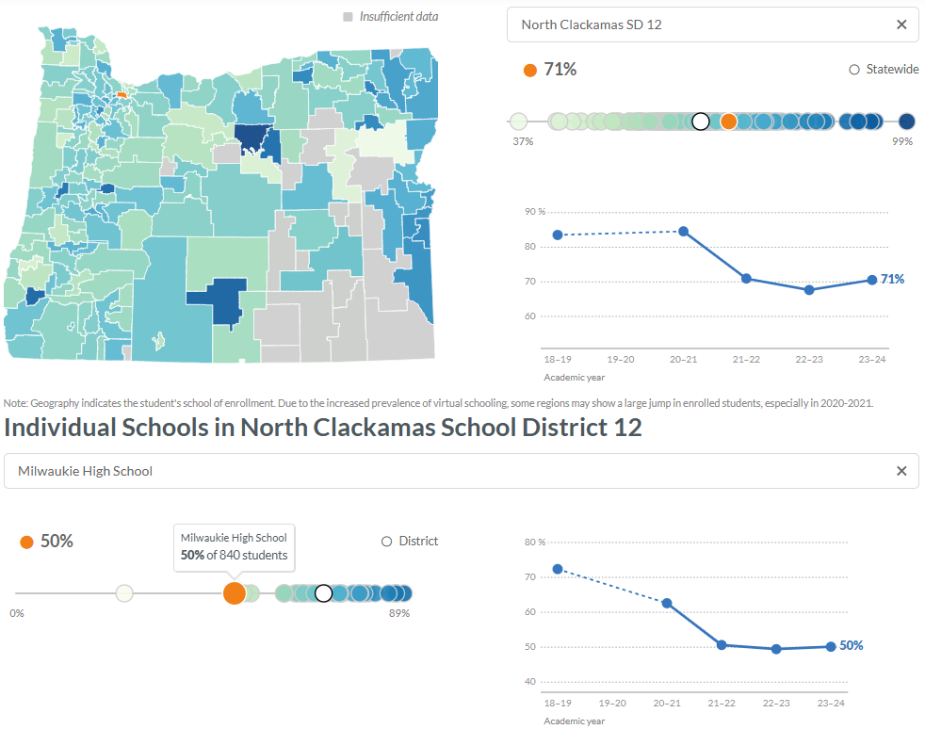
Individual Indicator Pages
Indicator page links
Juvenile commitment
Student houselessness
Regular attendance
High school graduation
Features of each page
Background: Issue context, state trend, national comparison, indicator-specific deep dive
Sociodemographics: Can select multiple
Multiple geographies: Specific to indicator
Key child experiences: Specific to indicator
Resource list: Relevant OCID, agency, national research

Slide 27
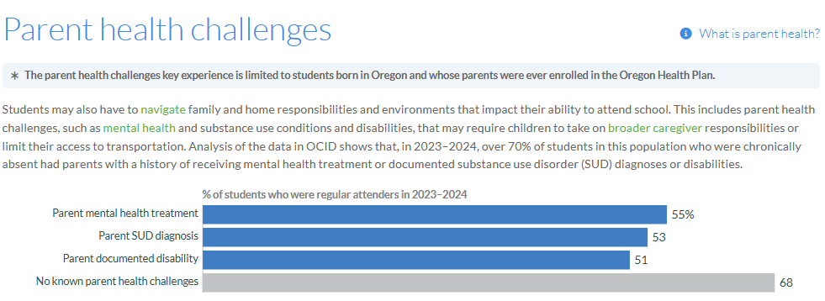
Individual Indicator Pages
Indicator page links
Juvenile commitment
Student houselessness
Regular attendance
High school graduation
Features of each page
Background: Issue context, state trend, national comparison, indicator-specific deep dive
Sociodemographics: Can select multiple
Multiple geographies: Specific to indicator
Key child experiences: Specific to indicator
Resource list: Relevant OCID, agency, national research

Slide 28
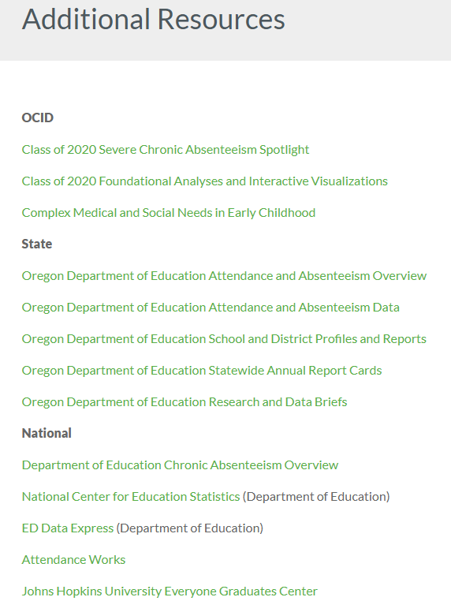
Individual Indicator Pages
Indicator page links
Juvenile commitment
Student houselessness
Regular attendance
High school graduation
Features of each page
Background: Issue context, state trend, national comparison, indicator-specific deep dive
Sociodemographics: Can select multiple
Multiple geographies: Specific to indicator
Key child experiences: Specific to indicator
Resource list: Relevant OCID, agency, national research

Slide 29
OCID Child Well-being Dashboard Live Demo https://www.ocid-cebp.org/child-well-being-dashboard/

Slide 30
Development Teams
Medicaid by the Numbers:
Hayley De Carolis, Chelsea Keating, David Radley, Morgan Reeder, Erin Sanborn, Nanda Vallamkondu, Dan Vizzini
OCID Child Well-being Dashboard
Jesse Baumgartner, Dylan Miksicek, Gretchen Morley, David Radley, Morgan Reeder

Slide 31
Questions and Discussion
Medicaid Policy Matters Webinar Series

Slide 32

Telehealth and Pediatric Screenings
Thursday, July 16, 2026 at 11:00am (PT)

