Slide 1
Medicaid Policy Matters Webinar Series
Telehealth and Pediatric Preventive Care: Lessons for Rural Health Transformation
July 16, 2026

Slide 2
Webinar Aims
INTRODUCTION
By the end of the webinar, participants will be able to:
01
Explain how telehealth fits into Rural Health Transformation Program (RHTP) goals
02
Review post-public health emergency lessons for pediatric preventive telehealth
03
Identify hybrid care models and implementation guardrails
04
Discuss state considerations for using RHTP initiatives to strengthen pediatric access

Slide 3
Executive Summary
INTRODUCTION
A practical framing for telehealth in pediatric preventive care as states implement
Rural Health Transformation Program initiatives
CORE MESSAGE
01
Telehealth is best understood as connective clinical and operational infrastructure, not a standalone virtual service line.
VALUE CREATED
02
Its value is moving expertise, information, monitoring, and care-management capacity across distance.
INTENDED EFFECT
03
It should reduce avoidable travel, delay, duplication, and fragmentation while preserving local accountability.
CLEAR BOUNDARY
04
It does not replace necessary physical exams, immunizations, laboratory testing, emergency evaluation, or hands-on local care.

Slide 4
About the Center for Evidence-based Policy

Slide 5
About Our Work
Center for Evidence-based Policy
Rigorous and neutral research and technical assistance services to support state policymakers
Evidence review and synthesis
Data analytics including administrative data integration, management, and analysis
Policy analysis
Technical assistance (operational and process-related)
Trainings and workshops on evidence-based decision making

Slide 6
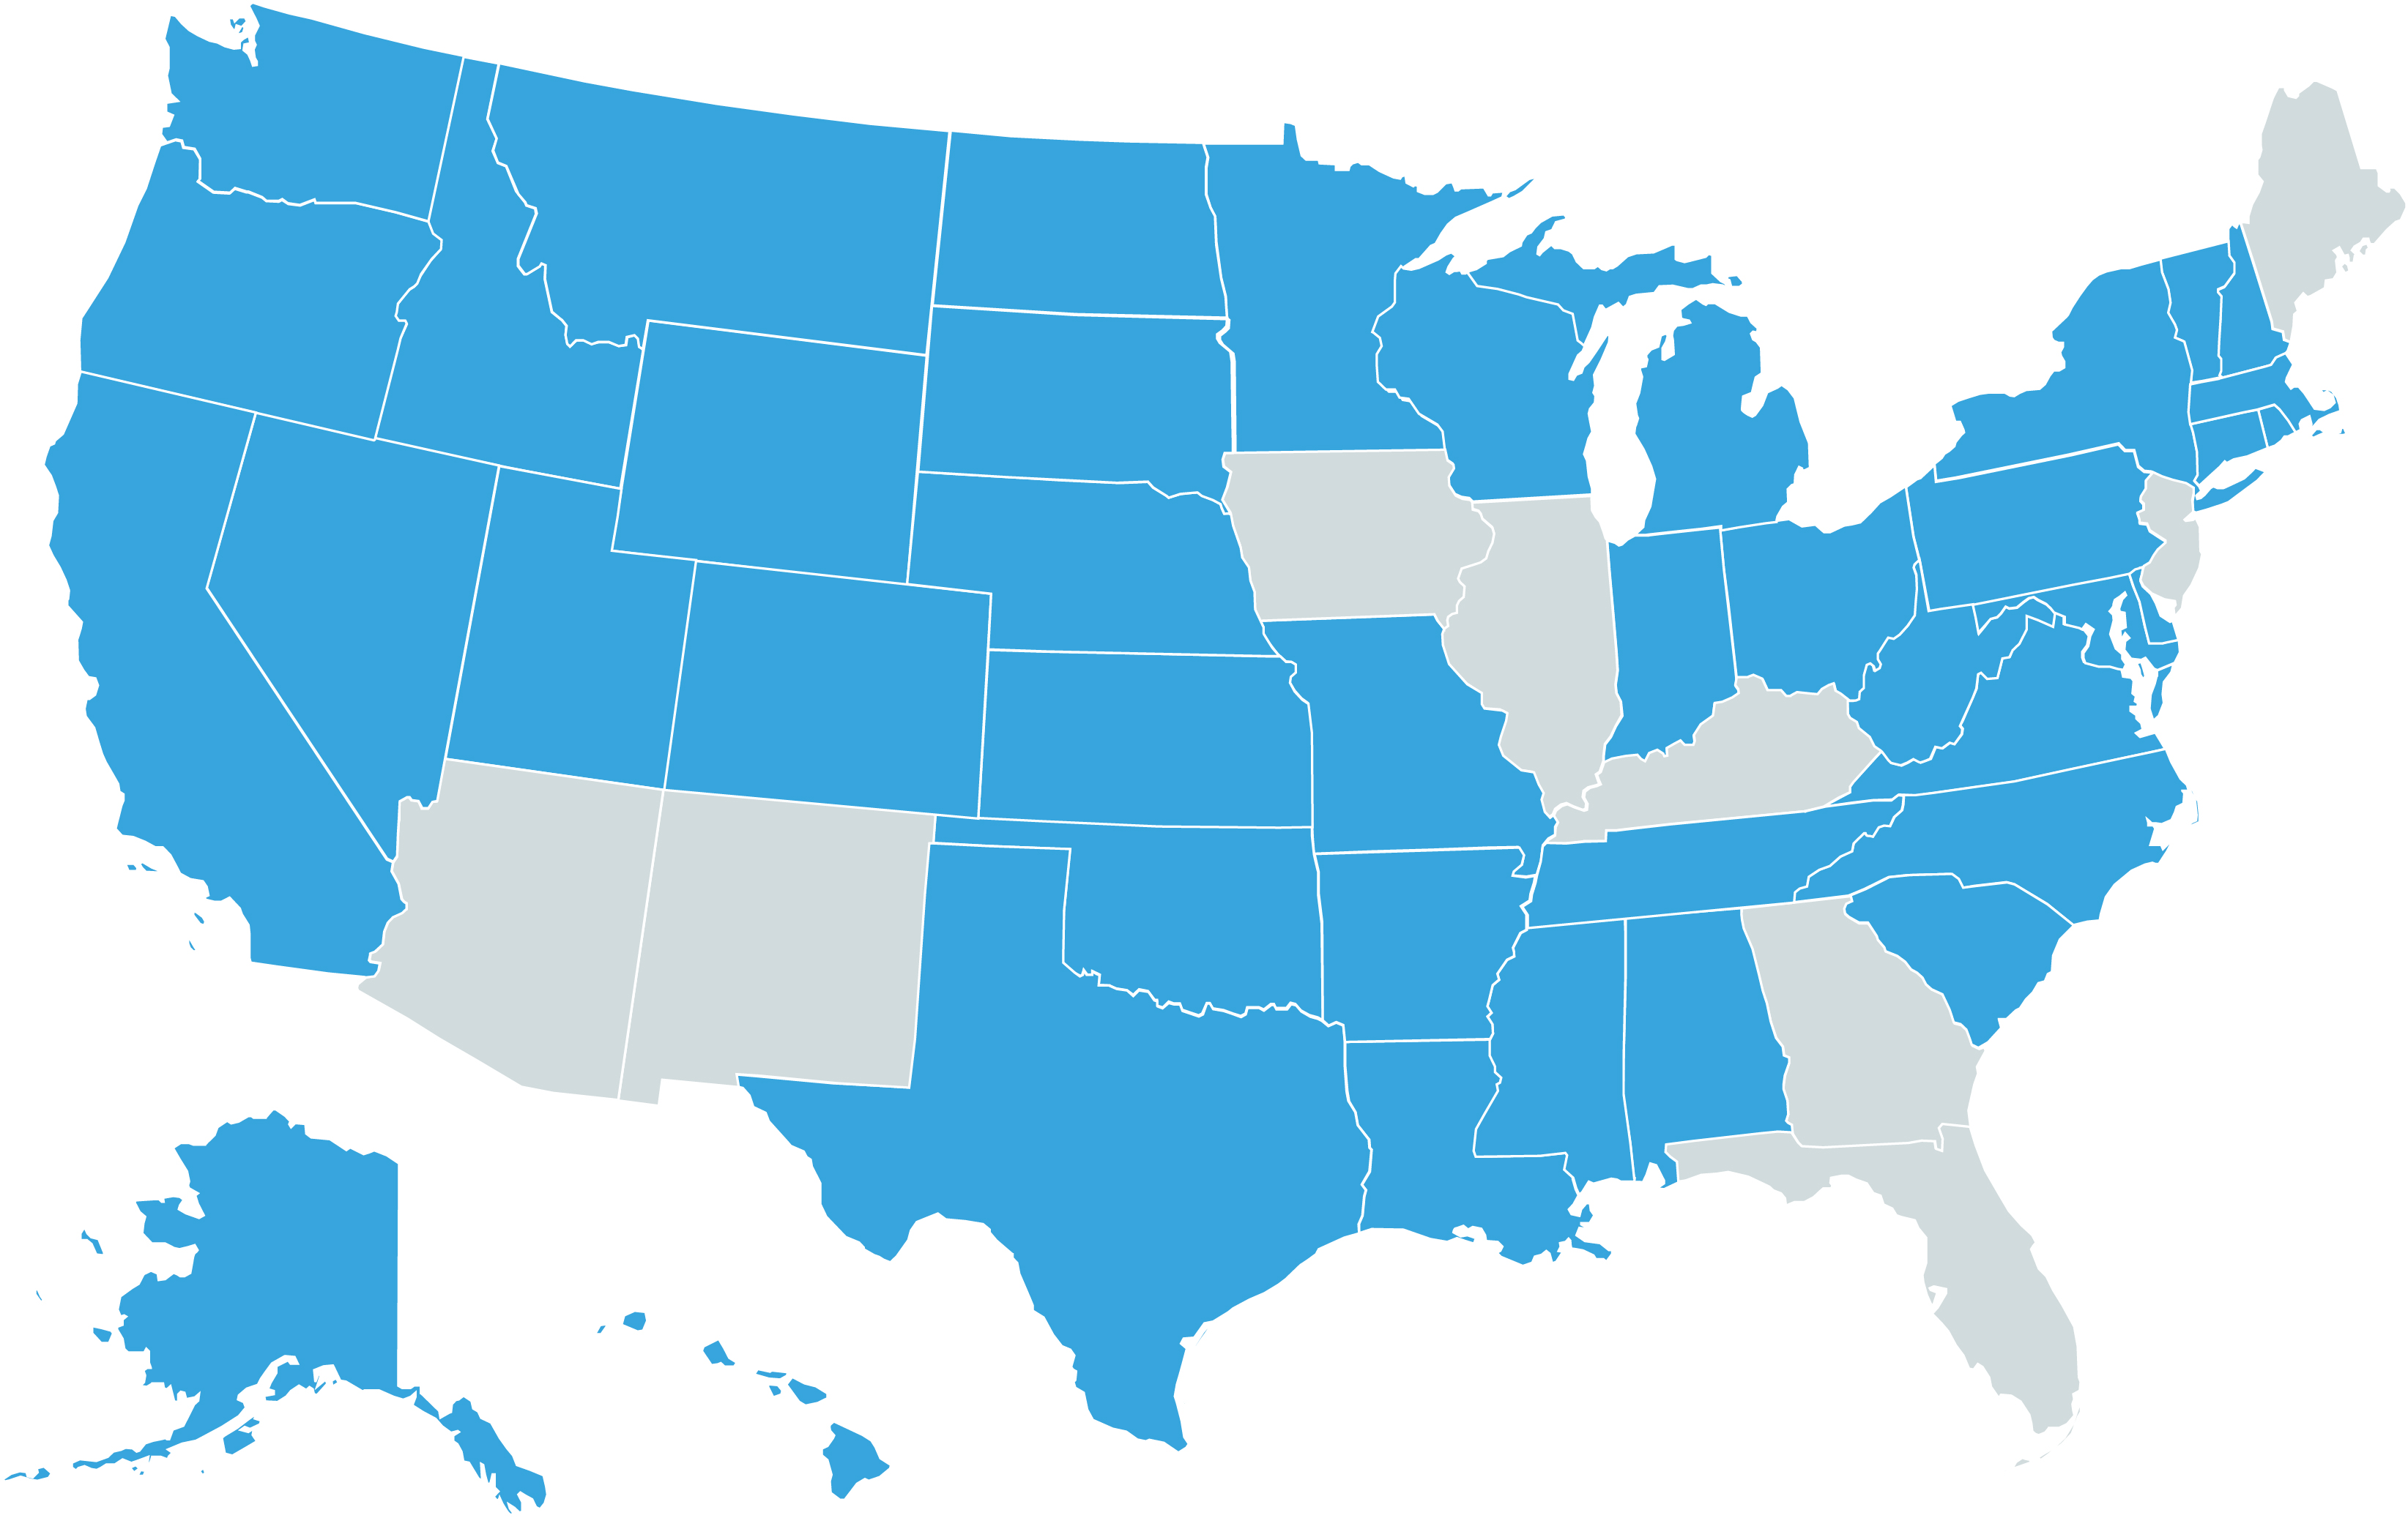
State Partnerships Since 2003
Center for Evidence-based Policy
States served

Slide 7
About Our Organization
Center for Evidence-based Policy
Established in 2003 at Oregon Health & Science University
Our work is driven by states, 90% in Medicaid
We are not funded by industry or associations
We are nonpartisan and we do not lobby
Our work is typically proprietary

Slide 8
Who Are We?
Center for Evidence-based Policy
Our Staff
Systematic reviewers
Policy analysts
Physicians
Pharmacists
Nurses
Genetics professionals
Epidemiologists
Librarians
Data scientists
Technical editors
Researchers
Our Work in 2025
Produced 50 evidence reports
23 policy briefs
Researched 40 topics
Screened over 30,000 titles and abstracts
11 surveillance reports
Graded 600 articles for quality
180 unique projects
Today
Virgil Dickson
Senior Policy Analyst
Kate Lonborg
Senior Policy Analyst
Amy Clary
Director of MED
Pam Curtis
Director
Kelsey Platt
Project Coordinator

Slide 9
Telehealth and Pediatric Preventive Care: Lessons for Rural Health Transformation

Slide 10
Rural Health Transformation Program Overview
Rural Health Transformation Program (RHTP) provides $50 billion to states for federal fiscal years 2026 through 2030, with tight timelines to implement initiatives
CMS frames RHTP with 5 strategic goals: prevention and chronic disease management, sustainable access, workforce development, innovative care, and technology
Telehealth is a natural fit for RHTP; many states are implementing telehealth initiatives and complementary initiatives that can reinforce effectiveness
Notes:
Kate
Many of you are probably familiar with the Rural Health Transformation Program, so we’ll keep this context quick.
The Rural Health Transformation Program (RHTP) was established under the 2025 budget reconciliation law (the One Big Beautiful Bill Act). It provides $50 billion in funding to states in federal fiscal years 2026 through 2030
All 50 states approved for RHTP funding for 2026, in varying amounts
Timelines to launch RHTP initiatives are tight: 2026 funds to be committed by October 30, 2026, and spent by September 30, 2027
Unused funds to be reclaimed by CMS. So states are under pressure to work quickly
In setting up the Rural Health Transformation Program, CMS identified 5 strategic goals related to prevention and chronic disease management, sustainable access, workforce development, innovative care, and technology
Telehealth is a natural fit within those goals. States are pursuing telehealth initiatives and initiatives that complement work on telehealth
CMS suggestions in NOFO:
Telehealth specialty consult programs to improve access to care and address workforce gaps in rural areas
Technology use to include expanding telehealth, using remote patient monitoring to manage chronic illnesses
Infrastructure for telehealth, such as broadband access or equipment to enable telehealth services
Remote care services initiative that could include TA, telehealth equipment, IT solutions for integrating data from remote monitoring devices and sharing data across the virtual care team, supporting patients in understanding how to use new technologies
CMS also promoted state policy actions to support telehealth
Licensure compacts to allow nurses or psychologists, for example, to practice in person or through telehealth in multiple states
State laws and Medicaid reimbursement policies to enable delivery of care thru telehealth
State Reporting Template still doesn’t seem to be available. This rescoring webinar from February reviews CMS’s preliminary guidance on reporting: https://www.cms.gov/files/document/rht-program-reporting-rescoring-webinar-02-25-26.pdf
FAQs updated in April still refer to 2/25/26 webinar: https://www.cms.gov/files/document/frequently-asked-questions-april-2026.pdf

Slide 11
RHTP Initiatives: Examples Enabling or Complementing Telehealth
Telehealth community access points (e.g., in libraries, community centers, or churches)
School-based health centers and tele-behavioral health, tele-dentistry, etc.
E-consults, provider-to-provider consultation, and Project ECHO-style workforce support
Remote patient monitoring for people with chronic disease with staffed workflows and escalation rules
Digital navigation, EHR/HIE integration, cybersecurity, and closed-loop referral infrastructure
Notes:
Kate, then pass to Virgil
State RHTP initiatives enable or complement telehealth services in a variety of ways. Many states are working on funding acquisition of equipment so that clinicians can deliver care via telehealth
Other initiatives focus on enabling patients to access care through telehealth. In rural communities where patients may not have broadband or other needed technology at home, some states are establishing access points in communities. For example, Delaware is building on prior pilot work with booths in libraries offering a private space with high-speed internet access and navigation support where rural residents can access care closer to home. Other states are supporting telehealth access points in community centers, churches, pharmacies, local public health departments, and grocery stores
Some states are pursuing initiatives to expand school-based health centers in rural communities or offer additional services in SBHCs to address, for example, behavioral or oral health needs
States also are pursuing multiple workforce initiatives. Initiatives related to provider-to-provider consultation or establishing a Project ECHO can help rural clinicians care for more complicated needs locally, enabling follow-up care or complementing specialty care delivered through telehealth.
Remote patient monitoring initiatives include, for example, work in Texas to offer patient-facing health portals integrating with remote patient-monitoring devices and facilitating communication with the care team. Multiple states have initiatives to provide technical assistance to clinicians and staff about best practices for remote patient monitoring
Underlying this, there are cross-cutting technology initiatives in multiple states addressing needs such as integrating electronic health records and health information exchange, improving cybersecurity, and setting up closed-loop referral infrastructure

Slide 12
Pediatric Opportunities Under RHTP
01
Use registries and outreach to identify children overdue for well-child care, developmental screening, immunization, oral health, lead testing, and behavioral health follow-up.
02
Pair virtual screening and counseling with scheduled local completion for physical exam, vaccines, labs, and referrals.
03
Support schools, community health workers, primary care, and public health partners as part of the same pediatric care pathway.

Slide 13
Connecting Medicaid Policy and RHTP
States have opportunities to connect telehealth policy choices and RHTP initiatives to support better care in rural communities.
1
Post-PHE telehealth flexibilities
2
RHTP-funded initiatives
State Medicaid agencies are deciding which pediatric preventive-care flexibilities to retain.
RHTP initiatives can support access points, remote care, data exchange, workforce capacity, and care coordination.
+
OPPORTUNITY
Connect these efforts into hybrid pathways that complete care, rather than just increasing virtual encounters.

Slide 14
Telehealth in an RHTP-Supported Delivery System
RHTP funding creates opportunities to use telehealth to move expertise, information, monitoring, and follow-up through rural care systems, rather than simply add a separate virtual product.
1
Policy
2
Design
3
Pediatric care
States can align rural access, prevention, workforce, care models, and technology infrastructure.
Telehealth is more effective when embedded in local delivery systems, not bolted on as a separate service line.
Virtual and in-person care must connect to complete screening, vaccination, testing, referral, and follow-up.

Slide 15
What Telehealth Connects
Patient and family
transportation, technology, medications, and follow-up needs
Local access point
clinic, school, hospital, public health site, mobile unit, pharmacy, or community hub
Regional clinical capacity
specialists, behavioral health clinicians, pharmacists, nurses, and care managers
Shared information infrastructure
electronic health records, health information exchange, registries, alerts, referrals, and shared care plans
Local completion and escalation
examination, vaccines, laboratories, imaging, medication administration, emergency stabilization, and transfer
Notes:
Background
Key Questions
Methods
Findings
Discussion
State Considerations

Slide 16
Medicaid Use of Telehealth for Pediatric Populations
During and After the Pandemic

Slide 17
What We Reviewed: 8 State Medicaid Programs
States reviewed (8): Arizona, California, Kentucky, Maryland, Minnesota, New York, South Carolina, and Vermont
Time period: federal fiscal years 2019–2023
Data sources: Centers for Medicare & Medicaid Services (CMS) Child Core Set annual reporting data; Form CMS-416 reporting data; state Medicaid utilization data; interviews with state Medicaid staff
Key terms:
Early and Periodic Screening, Diagnostic, and Treatment (EPSDT): Medicaid’s comprehensive preventive care benefit for children and adolescents under age 21
Child and Adolescent Well-Child Visits (WCV-CH): the Child Core Set measure of whether children ages 3 to 21 received at least 1 well-care visit during the year

Slide 18
Telehealth Counting Rules Changed From 2025 to 2026
COVID-ERA EXPANSION
Medicaid/CHIP telehealth rose from 0.3% pre-PHE to 20.2% in 2020 Q2.
Hybrid care preserved contact when in-person visits were disrupted.
Measurement rules changed.
JANUARY 2025 GUIDANCE
Allowed synchronous audiovisual visits in the numerator of the Core Set measures for Child and Adolescent Well-Care Visits (WCV-CH) and Well-Child Visits in the First 30 months (W30-CH).
Reflected the then-current 2025 Core Set specifications.
2026 REPORTING
The 2026 Core Set specifications clarify that telehealth visits do not count toward the numerator for WCV-CH and W30-CH.
Virtual visit components may support EPSDT, but hands-on services still require local completion.
Sources: CMS 2025 Telehealth Allowance TA Resource (Jan. 2025); CMS 2026 Child Core Set Summary of Updates (Jan. 2026).
Notes:
JANUARY 2025 GUIDANCE
The 2025 telehealth resource allowed synchronous audiovisual well-care visits in the numerator of WCV-CH and W30-CH numerators.
Those allowances reflected the then-current 2025 Core Set specifications.
2026 REPORTING
WCV-CH and W30-CH now clarify that telehealth visits do not count toward the numerator.
Virtual components may support EPSDT, but hands-on services still require local completion

Slide 19
Federal Guidance After the Public Health Emergency
Telehealth as A Workforce Strategy (CMS 2024 guidance)
Urged sustaining telehealth for preventive care
Addressed clinician shortages, geographic barriers, scheduling constraints
Recommended enrolling more clinicians, including out-of-state
Framed as ensuring all EPSDT-eligible children receive full preventive services
PL 119-21 (Signed 7/4/2025) — Major Changes:
New community engagement requirements
6-month redeterminations (increased churn risk)
Eliminated temporary FMAP increase (fiscal pressure)
$50 billion Rural Health Transformation Program for capacity and technology

Slide 20
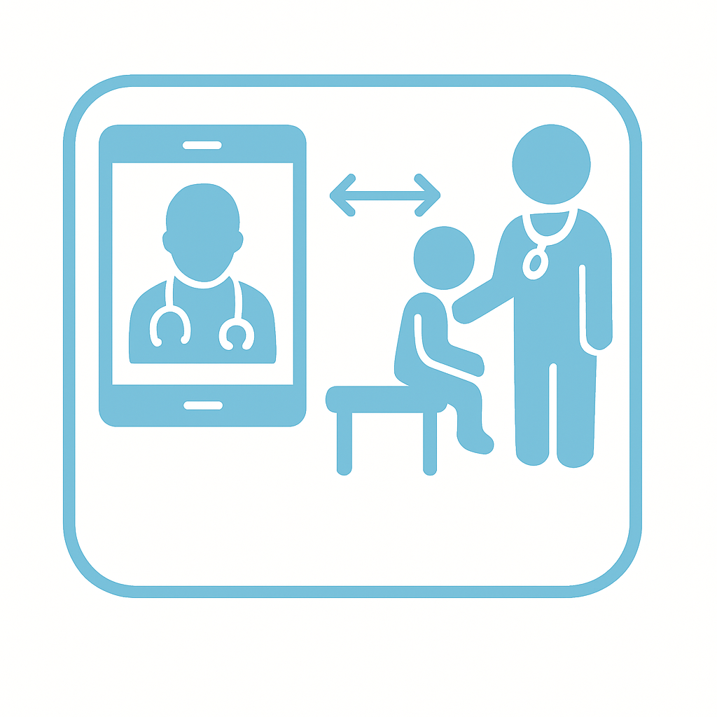
What is Hybrid Care?
HHS: hybrid integration of telehealth with in‑person care
Medicaid programs aim to use hybrid care to increase pediatric preventive screenings
Image Source. Canva

Slide 21



Three Frameworks
Hybrid strategies across reviewed Medicaid programs are clustered into 3 approaches along a continuum:
Clinician Discretion
Code-Set Governance
Prescriptive Hybrid Rules
Most states blend elements from more than 1 approach

Slide 22

Utilization Profile: Behavioral Health Dominance
Most pediatric telehealth encounters related to mental and behavioral health or neurodevelopmental diagnoses
Primary care and preventive telehealth use was relatively limited
Source: State Medicaid utilization data summarized in MED report.

Slide 23


Utilization by Age
Telehealth use increased with age
Adolescents had the highest recorded pediatric telehealth volumes in Arizona, New York, and Vermont; California data generally supported the same pattern.

Slide 24

High-Frequency Use, Then Normalization
Children and adolescents became high-frequency telehealth users during 2020 and 2021
Use decreased as emergency measures ended, though adolescent behavioral health use remained elevated

Slide 25
Telehealth Counts Differently Across Pediatric Measures
Child and Adolescent Well-Care Visits (WCV-CH)
Ages 3–21
Tracks whether a child had at least 1 comprehensive well-care visit
During COVID PHE, telehealth visits counted
For 2026 Core Set reporting, telehealth visits do not count
EPSDT Participation Report (CMS-416)
Under age 21
Tracks completed screenings against the state’s expected schedule
Telehealth may count when clinically appropriate and allowed by state rules
In-person follow-up is still needed for hands-on exams, vaccines, or lab tests
Notes:
Ages 3–21
Tracks whether a child had at least 1 comprehensive well-care visit
During COVID PHE reporting was allowed via telehealth
For 2026 reporting, telehealth visits do not count toward this measure
EPSDT / CMS-416
Under age 21
Tracks completed screenings against the state’s expected schedule
Telehealth may count when clinically appropriate and allowed by state rules
In-person follow-up is still needed for hands-on exams, vaccines, or lab tests

Slide 26
From Virtual Contact to Completed Care
VIRTUAL CONTACT
History and risk assessment
Developmental or behavioral screening
Counseling and care planning
LOCAL COMPLETION
Complete hands-on services:
Vitals, growth, and physical exam
Immunizations and laboratory testing
Hearing, vision, and oral health
CLOSED LOOP
Shared documentation
Defined completion window
Billing and completion status
Referral follow-up

Slide 27
Well-Child Visit Rates Improved Modestly, Then Stalled
7 of 8 states improved from 2021 to 2023 (mean: +2.5 points); momentum stalled in 2023.
Measure changes limit pre-2021 comparisons.
2021
2023
Source: Centers for Medicare & Medicaid Services, Child Core Set annual reporting data, Child and Adolescent Well-Child Visits measure, federal fiscal years 2021–2023, for the 8 state Medicaid programs reviewed.

Slide 28
Eligibility Grew While Reported Screening Volume Fell
12.26M eligible → 13.01M (+6.17%)
10.56M reported screens → 8.56M (–18.95%)
Screenings did not keep up with enrollment .
Source: Centers for Medicare & Medicaid Services, Form CMS-416 reporting data, federal fiscal years 2019–2023. Figures are aggregates across the 8 state Medicaid programs reviewed: Arizona, California, Kentucky, Maryland, Minnesota, New York, South Carolina, and Vermont.

Slide 29
Telehealth Can Support—but Not Complete Every Component
WCV-CH
EPSDT / CMS-416
At least 1 comprehensive well-care visit.
2026 Child Core Set: telehealth visits do not count in the WCV-CH numerator.
Age-appropriate screens under state periodicity.
Virtual components may support EPSDT; hands-on services require local completion.
Completed care depends on the applicable measure specification, documentation, and a closed local pathway.
Sources: CMS 2026 Child Core Set Summary of Updates; CMS 2025 Telehealth Allowance TA Resource.

Slide 30
Plausible Explanations for the Gap
The evidence identifies possible explanations—not causal findings:
Telehealth fits talk-based services better than hands-on screening components.
Limited modality tracking and unclear payment and completion pathways weakened follow-through.

Slide 31
RHTP IN PRACTICE
From Pandemic Lessons to RHTP Investments (1 of 2)
Four investment patterns now show how states are translating pandemic-era telehealth capacity into permanent rural care infrastructure.
01
HUB INFRASTRUCTURE
02
BEHAVIORAL HEALTH CAPACITY
State plans propose or fund telehealth hubs: local or regional sites or entities that connect rural patients and clinicians to remote care through staff, equipment, connectivity, and referral links.
State plans propose or fund telehealth to extend scarce child, youth, perinatal, and psychiatric expertise into rural schools and primary care settings, often through consultation, education, and school-linked services.
Examples: Hawaii’s Pili Ola access points, Arizona telehealth hubs and mobile clinics, Maryland’s CRISP-enabled infrastructure.
Examples: Tennessee’s perinatal and pediatric behavioral health teleconsultation opportunity, Wisconsin WISCOPE, Maine school-partnered youth tele-BH.

Slide 32
RHTP IN PRACTICE
From Pandemic Lessons to RHTP Investments (2 of 2)
Four investment patterns now show how states are translating pandemic-era telehealth capacity into permanent rural care infrastructure.
03
MATERNAL-CHILD CARE MODELS
04
OPERATING LAYER
State plans propose or fund hybrid maternal-child models that combine local care, tele-maternal-fetal medicine or specialty consults, tele-RNs, remote monitoring, and postpartum follow-up for pregnant patients, infants, and families.
State plans propose or fund the tools and staff that make telehealth reimbursable and usable: facilitators, navigators, remote patient monitoring devices, e-consult platforms, telehealth coordinators, training, and technical assistance.
Examples: Pennsylvania maternal health hubs, South Dakota maternal and infant health hubs, Oklahoma maternal remote patient monitoring and maternal-fetal medicine telehealth expansion
Examples: Maine facilitators and hubs, Vermont e-consult/remote patient monitoring grants, New Mexico e-consults and school-based telehealth triage.

Slide 33
Implementation Considerations for States
Define split-modality visits, completion windows, and payment for local follow-up.
Track whether pediatric care was delivered by video, phone, or in person—and whether any required in-person follow-up was completed.
Preserve audio-only access with clinical and documentation guardrails.
Pay for telepresenters, care coordination, and closed-loop referrals.
Check whether each pediatric measure allows telehealth before counting a virtual visit in 2026 quality reporting.
Source: CMS, Summary of Updates to the 2026 Child Core Set Measures (January 2026).

Slide 34
Additional Resources and Technical References
Webinar recording will be available on the Center website.
The public brief, Telehealth for Pediatric Preventive Screenings Post-COVID-19, is available on the Center website.
CMS, 2026 Child Core Set Summary of Updates (January 2026).
CMS, 2025 Telehealth Allowance Technical Assistance Resource (January 2025).
NCQA, HEDIS MY 2025 Volume 2 Summary of Changes.
MED states retain access to the full report; contact med@ohsu.edu for more information.

Slide 35
Questions and Discussion
Medicaid Policy Matters Webinar Series

Slide 36
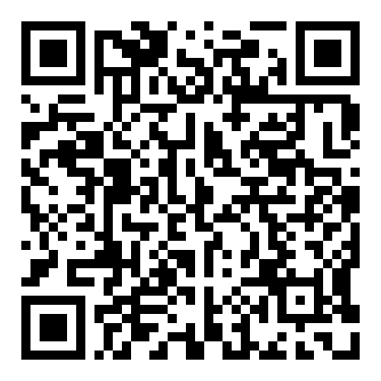
Join our mailing list to hear about future webinars!

